Slide 1
SIN & TEMPTATION

Slide 2
SIN IS A PREFERENCE FOR “SELF” OVER GOD
Some acts are always evil, and a good intention can never make an evil act good.
ORIGINAL SIN – The disobedience to God’s command by our first parents out of pride, self-love, and lack of trust in him; the cause of our fallen human nature.
VENIAL SINS – a less-grave sin that still wounds the soul, weakens the will, and can lead to mortal sin
MORTAL SINS – a grave sin that is committed with full knowledge and intent

Slide 3
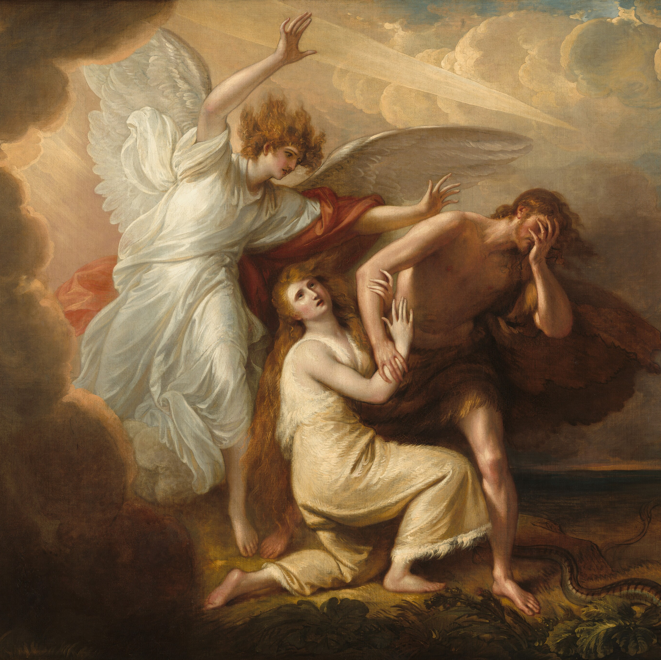
EFFECTS OF SIN
Offense to God’s justice and shatters our relationship with Him.
Darkens our intellect, weakens our will, and strengthens CONCUPISCENSE.
Harms the Church, the Body of Christ, and human society.
Merits punishment, either in this world or the next, as a natural consequence.

Slide 4
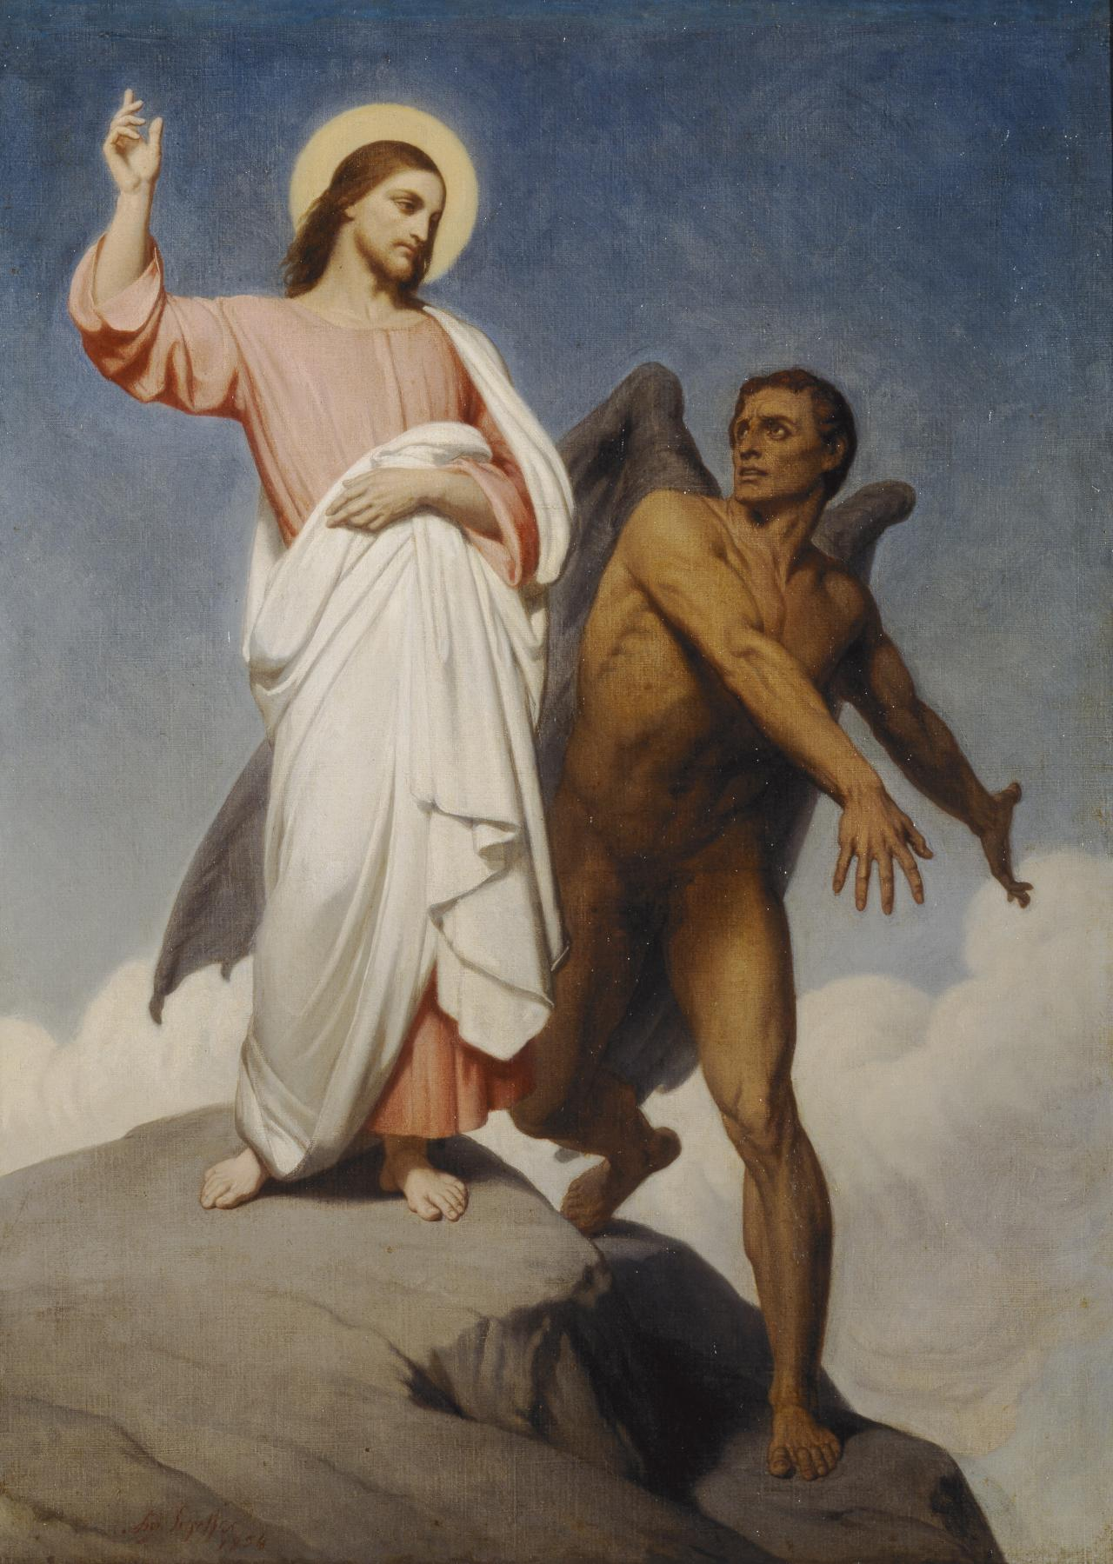
STEPS FROM TEMPTATION TO SIN
Recognize that you are being tempted – temptation itself is not sin.
Jesus himself was tempted! (Matthew 4:1-11)
Drawing near to what is forbidden – not removing yourself from the “near occasion to sin”
Listening to the desire – nourishing an interest in what is sinful.
Yielding to the attraction and falling into sin.

Slide 5
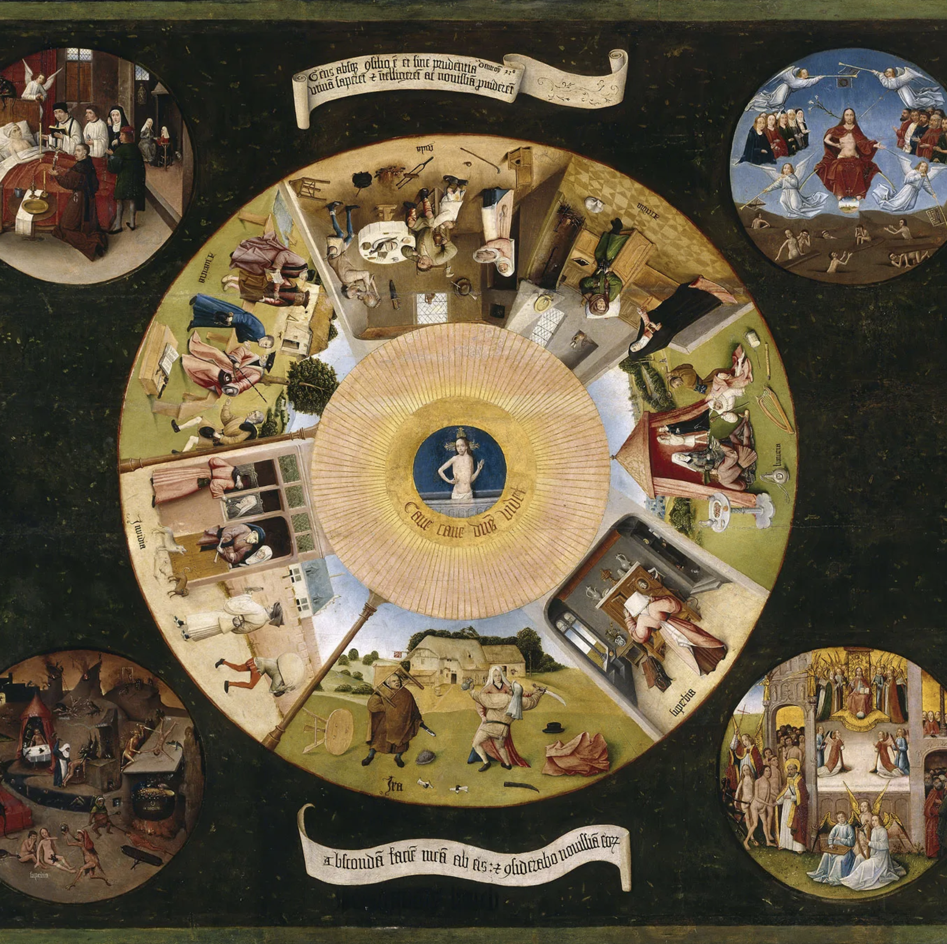
SEVEN DEADLY SINS
PRIDE
GREED
ENVY
LUST
ANGER
GLUTTONY
SLOTH
The opposing virtues are humility, detachment, charity, generosity, gratitude, meekness, gentleness, patience, purity, self-mastery, self-control, zeal for the good, perseverance.

Slide 6
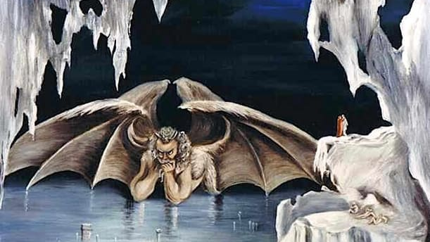
The Inferno (Dante Alighieri)

Slide 7
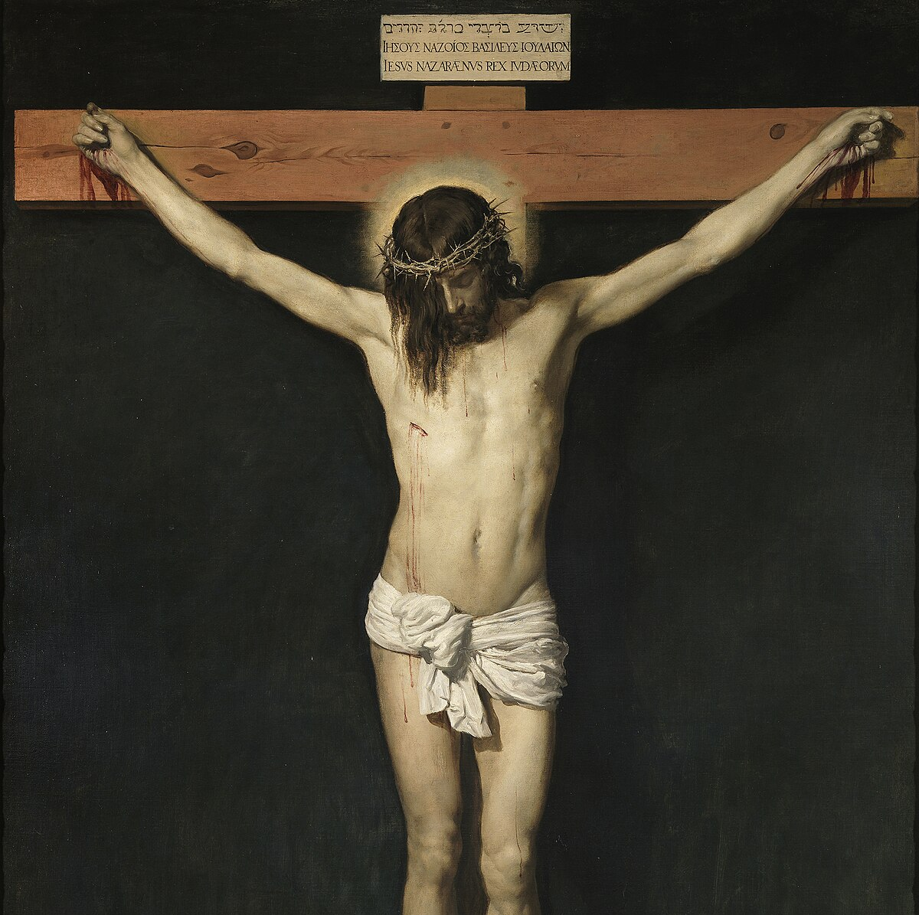
THROUGH JESUS, GOD OFFERS FORGIVENESS
God is merciful – the Father wills to offer forgiveness for all offenses to any who would repent
Jesus was sent for this purpose – the Father sent his Son to make reconciliation possible for the whole world
Jesus offers himself in sacrifice on the cross to accomplish the will of the Father

Slide 8
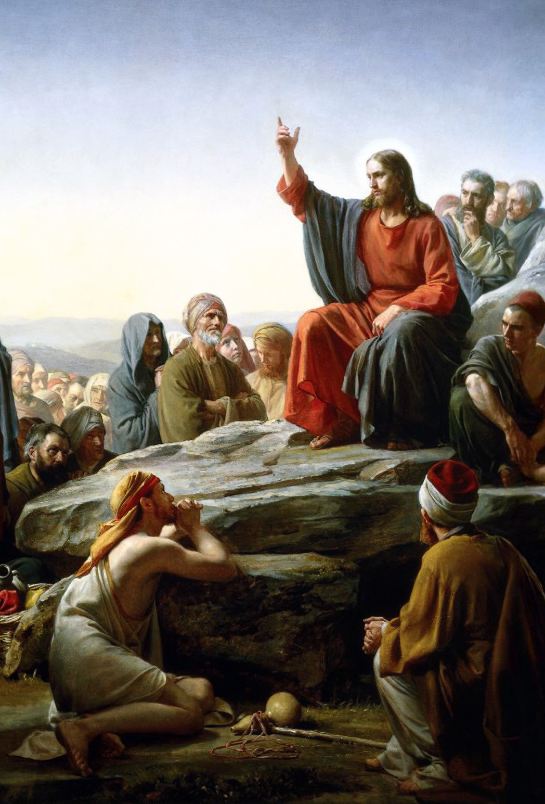
RESPONSIBILITIES BEFORE GOD
Examine your conscience regularly.
The Beatitudes
The Ten Commandments
The Lord’s Prayer
Laudate App / Other Resources
Avoid temptations
Renounce the pleasure of sin, which can lead to addiction to sin
Repent of sin and ask forgiveness.
Trust that God’s grace is stronger than sin and Satan

Slide 9
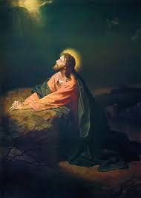
DEFENSES AGAINST SIN & TEMPTATION
Prayer – seek the Holy Spirit’s help and mercy and acknowledge our need for this presence in our weakness (St. Michael Prayer)
Mortification – (self-denial) try and give up or avoid things that are sinful and desirable which will strengthen the will to resist sin
Frequent reception of the Sacraments – Reconciliation and Eucharist
Follow Jesus – He commands us to seek holiness and desire eternal union with God
Plenary and Partial Indulgences – What are they?

Slide 10
DISCUSSION QUESTIONS
Why do we have to confess our sins to a priest?
Why does modern society find it hard to settle on a common understanding of what is right and what is wrong?
What are some examples of where contemporary society has become blind to sin?

Slide 11
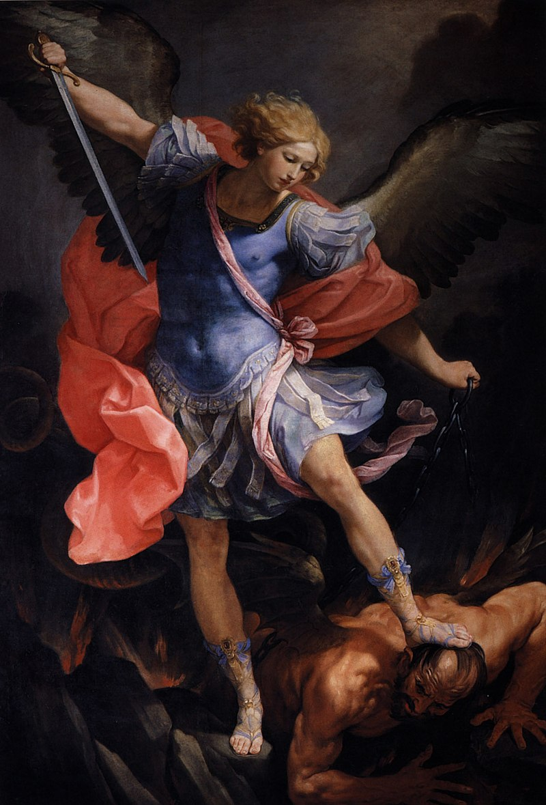
CLOSING PRAYER ST. MICHAEL PRAYER
St. Michael the Archangel, defend us in battle. Be our defense against the wickedness and snares of the Devil.
May God rebuke him, we humbly pray, and do thou, O Prince of the heavenly hosts, by the power of God, thrust into hell Satan, and all the evil spirits, who prowl about the world seeking the ruin of souls.
Amen.

