Slide 1
Advent

Slide 2
Why do we have a liturgical calendar?
Purpose: To unify the faithful in orienting our days around the person of Jesus
CCC 1194: “The Church, ‘in the course of the year…unfolds the whole mystery of Christ from his Incarnation and Nativity through his Ascension, to Pentecost and the expectation of the blessed hope of the coming of the Lord”
“In the absence of the Liturgical Calendar we will structure our lives around whatever shouts at us most loudly” www.osv.com

Slide 3
What is the liturgical calendar?
Schedule established for the Roman Catholic Church universal
Made up of seasons which direct our focus to a particular part of Jesus’ life, ministry, mission
How many seasons can you name?
Each season visually identified by use of associated liturgical colors for clerical vestments and also frequently of church decorations (banners / floral arrangements)
How many liturgical colors can you name?
Scripture readings for every Roman Catholic Mass throughout the world
Calendar of Feast days (e.g. St. Nicholas, St. Lucy, Our Lady of Guadalupe)
and Holy Days of Obligation (e.g. Immaculate Conception Dec. 8)
Who are the saints?
Notes:
The Church year is structured around the life of Jesus. It pursues Him from the first signs of His coming in Advent to His birth at Christmas, to His trials in Lent, and death on Good Friday, to the wonders of His Easter Resurrection and Ascension, and finally glimpses a vision of Him enthroned as King in glory (Feast of Christ the King – 11/25/2018)

Slide 4
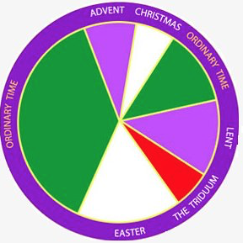
Liturgical Calendar
Advent
Christmas
Christmas Day -> Baptism of Our Lord (Sunday after Epiphany
Liturgical Color – White
Ordinary Time (Ordinal Time)
Between Baptism of Jesus and Ash Wednesday; between Pentecost and Advent
Focuses on Christ’s public ministry, and the early Church. Time of growth and maturation
Color: Green

Slide 5
Liturgical Calendar
Lent
Ash Wednesday until Holy Thursday
Penitential season preparing for Christ’s Passion
Liturgical Color : Purple (Laetare Sunday: Rose)
Triduum
What three feast days comprise the Triduum?
Liturgical Color: Red
Easter
Easter Sunday until Pentecost
Liturgical Color: White

Slide 6
Advent – a time of preparation
How do you prepare for a special guest?

Slide 7
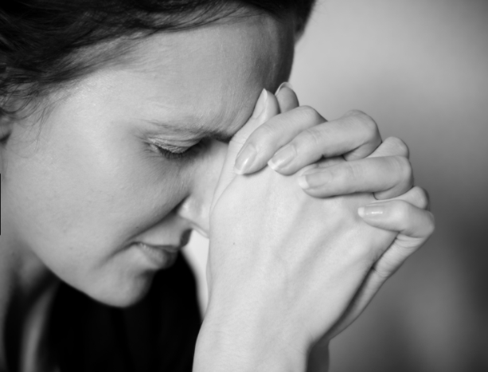
Advent – a time of preparation
First season of the Liturgical Year
Includes four Sundays, and begins on the Sunday nearest the feast of St. Andrew the Apostle (Nov 30) and ends on Christmas Eve
Why does the feast of St. Andrew begin Advent?
Liturgical color: purple (Gaudete Sunday: Rose)
The word advent is derived from the Latin adventus: ‘arrival’ or ‘approach’
Advent is a season of anticipation:
Hopeful longing
Joyful expectation
Prayerful penance
Spiritual preparation
Notes:
Ideas: St. Andrew is the one who brought Peter to see Jesus, together they leave their old lives behind and begin their lives anew with Jesus,

Slide 8
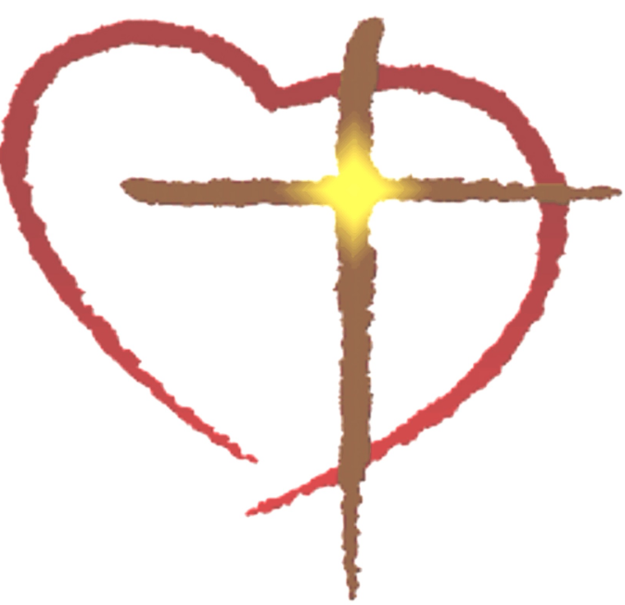
Advent
Our Past:
In Advent, we look back to the Incarnation of Jesus Christ in Bethlehem
We celebrate his immense love for us in taking on our humanity and walking with us, teaching us
Our Present:
When Jesus ascended into Heaven, He did not abandon us!
He is with us in the Sacraments, especially in the Eucharist, speaks to us in Scriptures, and walks with us in community with the Church He established!
Our Future:
Jesus is coming again and will be revealed in His full glory!
We are vigilant for his coming – He will not find us asleep!

Slide 9
Advent Traditions
The Advent Wreath
Why do we have an Advent wreath?

Slide 10
The Advent Wreath
Traditionally a ring of evergreen holding candles
Ring: signifies eternity of God – no beginning or end
Evergreen – eternal life with Christ
Sometimes holly with berries, symbolizing crown of thorns and His precious blood
The candlelight represents Christ, who entered this world to scatter the darkness of evil and show us the way of righteousness. The progression of lighting candles shows our increasing readiness to meet our Lord.
Candles are lit with accompanying prayers each night to mark the progress through Advent
How many candles are in the wreath and what colors are they?

Slide 11
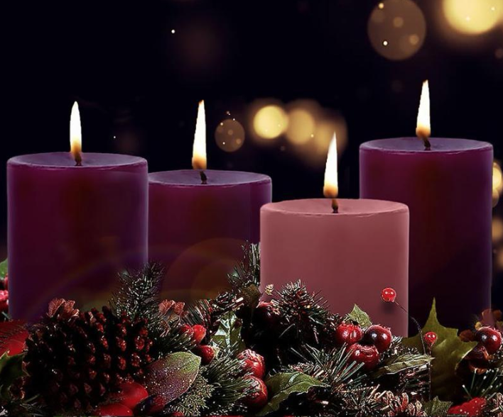
The Advent Wreath
The Four Candles – One for each Sunday of Advent
Hope: Jesus is coming!
Faith: Reminding us of Mary and Joseph’s journey to Bethlehem.
Joy: Gaudete Sunday - Our preparation is now half-finished and Jesus is coming!
Peace: “Peace on Earth, Good Will Toward Men.”

Slide 12
Advent Music
Advent Hymns help us experience this season of preparation, expectation, and waiting to celebrate the birth of the Lord.
_ _ _ _ _ _ _ _ (HINT: Latin for “Hail Mary”)
O Come, O Come _ _ _ _ _ _ _ _
What does ‘Emmanuel’ mean?
People Look _ _ _ _
_ _ _ _ _ _’_ Messiah
Let All Mortal Flesh Keep Silence
Come Thou Fount of Every Blessing

Slide 13
Advent Traditions Around the World…

Slide 14
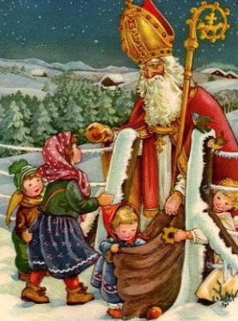
Eastern and Western Europe
Feast of St. Nicholas (Celebrated on December 6th in Western countries)
What do you know about St. Nicholas?
Bishop in Myra (now Turkey) in 4th C. who was known for his generosity
One story: a family in his community was desperately poor; the father had been unable to find husbands for his three daughters. One night, Nicholas came to their home and tossed three bags of gold into the open window (or down the chimney, in some versions)—thereby saving them from a terrible fate. This tale is probably the source of his eventual connection to the tradition of gift-giving at Christmas.
Over the next millennium, St. Nicholas gradually became associated with gift-giving. In the 12th century, nuns began placing gifts in the shoes of little children on St. Nicholas's Eve. The saint became an enchanting night-time benefactor
The custom spread with immigration to North America when Dutch children told their English-speaking friends about "Sinter Klaas," the bishop in red vestments who brought them surprises on his feast day. The American mispronunciation—Santa Claus—eventually took on a life of its own.

Slide 15
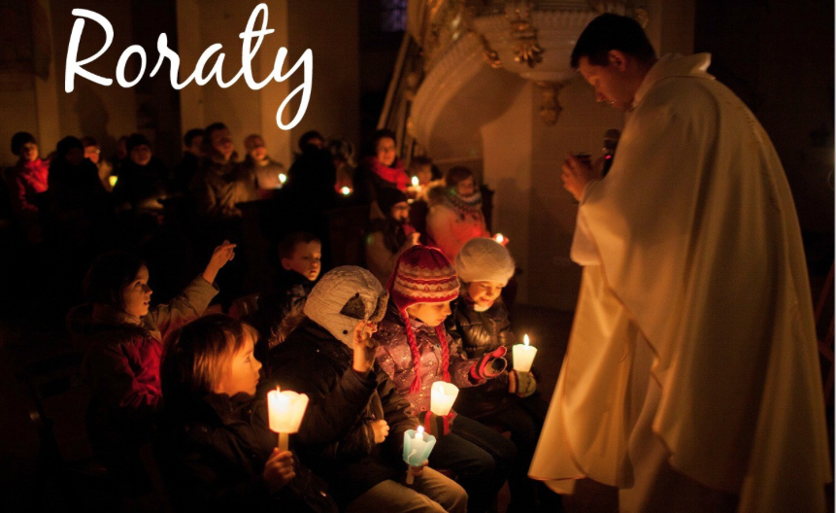
Poland
Roraty Mass: Early morning Mass celebrated throughout Advent beginning just before sunrise in almost complete darkness in the church. “Roraty” comes from the ancient Latin chant that is sung to begin the service: Rorate Coeli, de super; et nubes pluant justum – “O Heavens, drop down your dew from on high and may the Just One be rained by the clouds”. The words of the ancient hymn are a plea for God’s gift of His Son. As the hymn is sung candles are gradually lit in the dark church. The people wait in darkness not only for the rising of the sun but ultimately for the return of the Son of God, so beautifully symbolized by dawn’s first light.
Which pope, now a Saint, hailed from Poland?

Slide 16
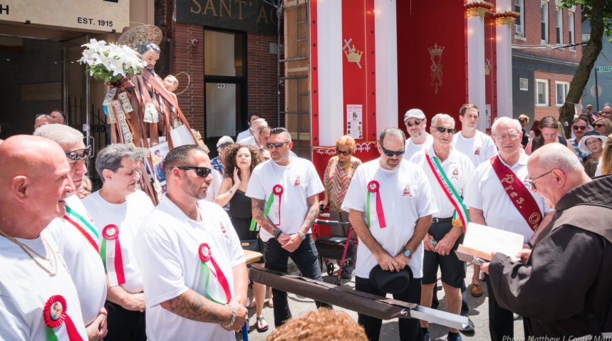
Alp
Alpine Countries
Josephstragen -- "carrying St. Joseph." Each night, a group of boys would carry a statue of St. Joseph to another boy's home. The next night, the boy who had been visited would join the procession, making the number of carriers grow progressively larger. On Christmas Eve all the boys, accompanied by schoolgirls dressed in white, would process the statue through the town to the church, where it would be placed near the manger.

Slide 17
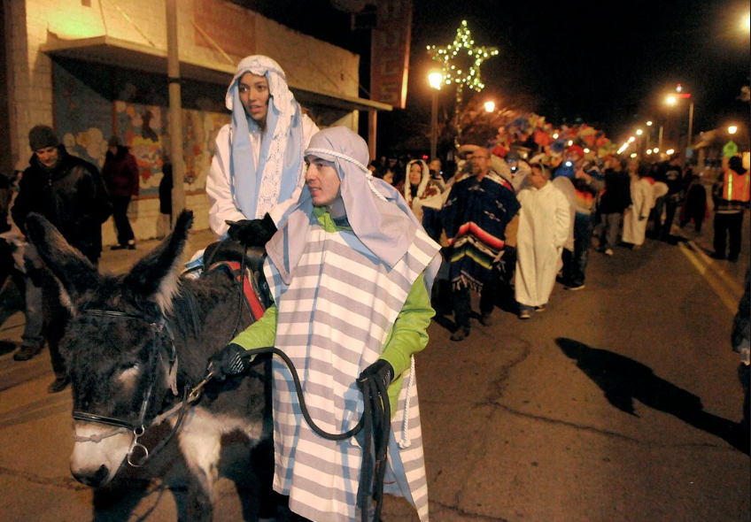
Latin America
La Posada (“The Inn”)
Re-enactment of the journey of Mary and Joseph to Bethlehem for the census and finding no place to stay. The participants go from door to door knocking and singing Advent and Christmas carols. All homes turn them away until the last one…

Slide 18
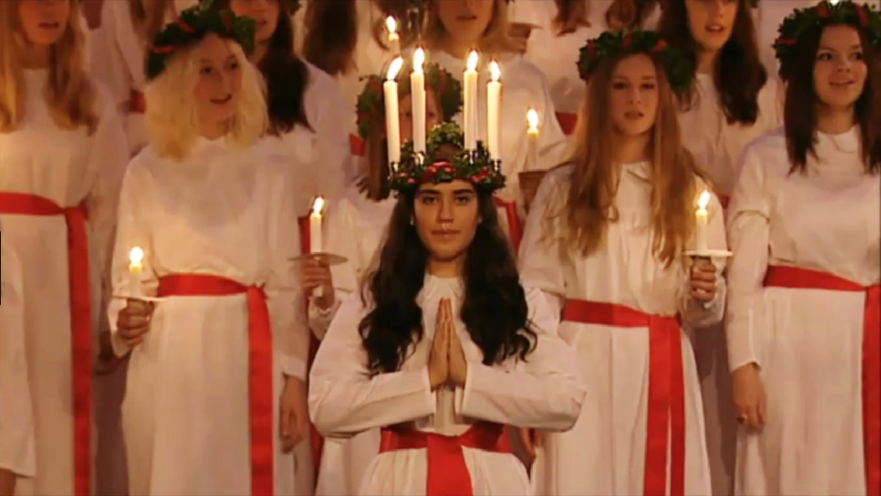
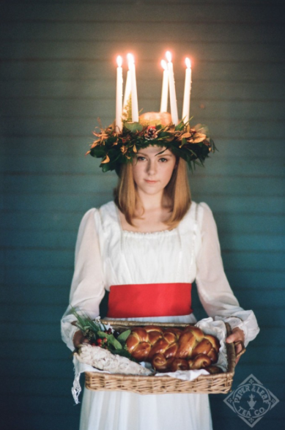
Scandinavia
Feast of St. Lucy – December 13. (283-304 A.D.) Christian martyr under Emperor Diocletian). Patron saint of the blind.
St. Lucy is the ”Saint of Light”, and is therefore an appropriate Advent figure to foreshadow the coming of Jesus, the Light of the World
Traditionally, the oldest girl of the household arises early and dresses as St. Lucy, wearing a white dress with red sash and a crown of candles. She presents a variety of pastries and cookies to the rest of the family.

Slide 19
Asia and the Middle East
Phillipines: Misas de Aguinaldo or “Gift Masses”. A novena of Masses beginning on December 16 and end on Christmas Eve. After every Mass, families celebrate together eating traditional desserts and sweets
China: During Advent, Christians light paper lanterns and display in their homes and windows
Middle East: “Barbara branch”. A twig from a fruit tree is placed in water. It is named after St. Barbara, a Christian martyr. It is said that things will go well for the family whose branch blooms on or before Christmas Day. This tradition comes from Jesus being the root that sprouts from the stump of Jesse.

Slide 20
What are your Advent Traditions?

