Slide 1
MATRIMONY AND HOLY ORDERS: SACRAMENTS OF SERVICE

Slide 2
Matrimony
Sacred Scripture begins with the creation and union of man and woman and ends with the “wedding feast of the lamb.” (Genesis 1:27 and Revelation 19:7, 9)
Scripture often refers to marriage, its origin and purpose, the meaning God gave to it, and its renewal in the covenant made by Jesus with his Church.
Man and woman were created for each other. By their marriage, a couple witnesses Christ’s spousal love for the Church. One of the Nuptial Blessings in the liturgical celebration of marriage refers to this in saying: “Father, you have made the union of man and wife so holy a mystery that it symbolizes the marriage of Christ and his Church.”

Slide 3
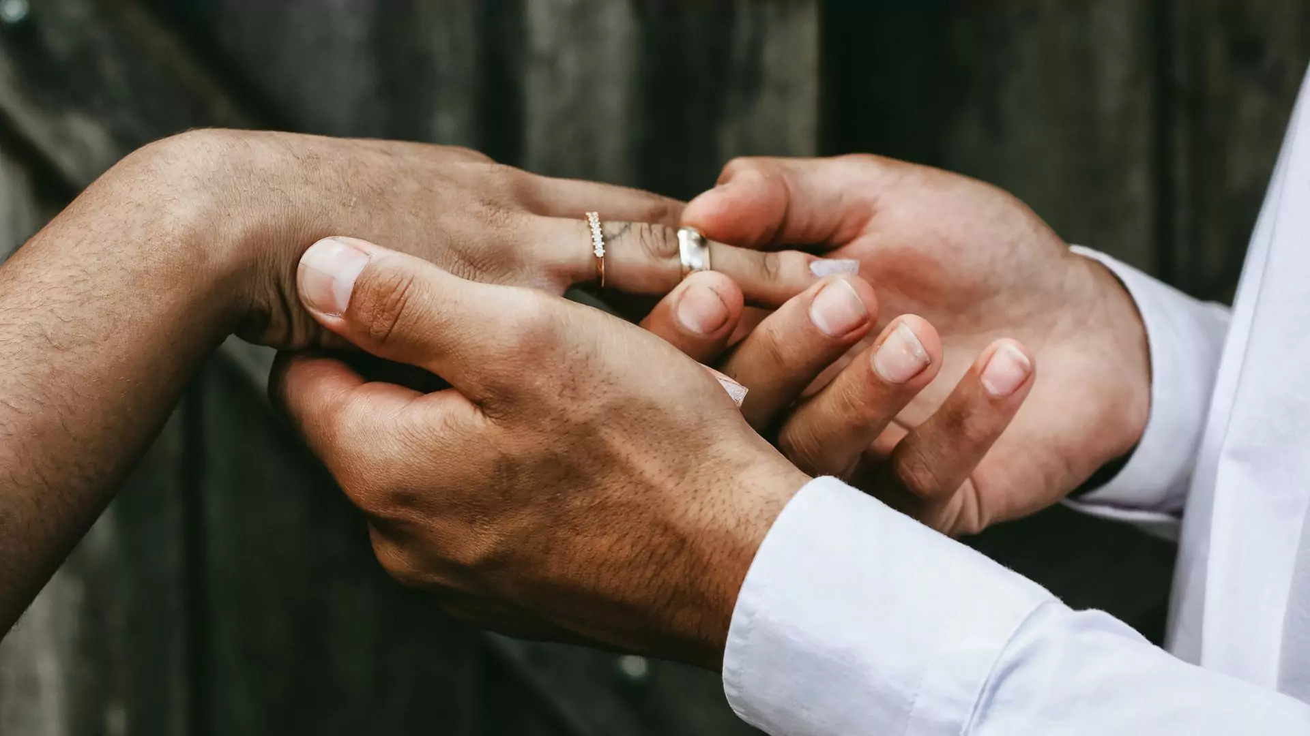
Matrimony
The Sacrament of Marriage is a covenant, which is more than a contract. A covenant always expresses a relationship between persons. The marriage covenant refers to the relationship between the husband and wife, a permanent union of persons capable of knowing and loving each other and God.
The celebration of marriage is also a liturgical act, appropriately held in a public liturgy at church. Catholics are urged to celebrate their marriage within the Eucharistic liturgy.

Slide 4
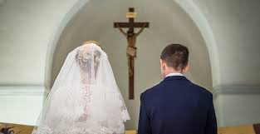
THE SACRAMENT
This is the only sacrament that lay people can administer—except for Baptism, in emergencies—and routinely do so. The presence of a priest or deacon is required for marriage, but he is not technically administering the sacrament. He is a witness.
MATTER: The mutual consent of the couple and their promise to live together as husband and wife in a lifelong union.
FORM: “I take you…” (spoken as a vow) or “I do” (spoken as an affirmation of the vow spoken by the representative of the Church).
NECESSARY CONDITIONS: Free, Fruitful, Faithful, Forever

Slide 5
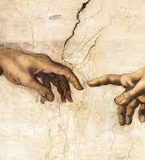
SAME SEX UNIONS
There are attempts by some in contemporary society to change the definition or understanding of what exactly constitutes marriage.
Efforts to gain approval for and acceptance of same-sex unions as marriages are examples. While the Church clearly teaches that discrimination against any group of people is wrong, efforts to make cohabitation, domestic partnerships, same-sex unions, and polygamous unions equal to marriage are misguided.
The Church and her members should continue to be a strong and clear voice in protecting an understanding of marriage, which is rooted in natural law and revealed in God’s law.

Slide 6
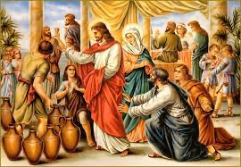
The Wedding at Cana
Jesus brought to full awareness the divine plan for marriage.
In John’s Gospel, Christ’s first miracle occurs at the wedding at Cana. “The Church attaches great importance to Jesus’ presence at the wedding at Cana. She sees in it the confirmation of the goodness of marriage and the proclamation that thenceforth marriage will be an efficacious sign of Christ’s presence” (CCC, no. 1613).

Slide 7
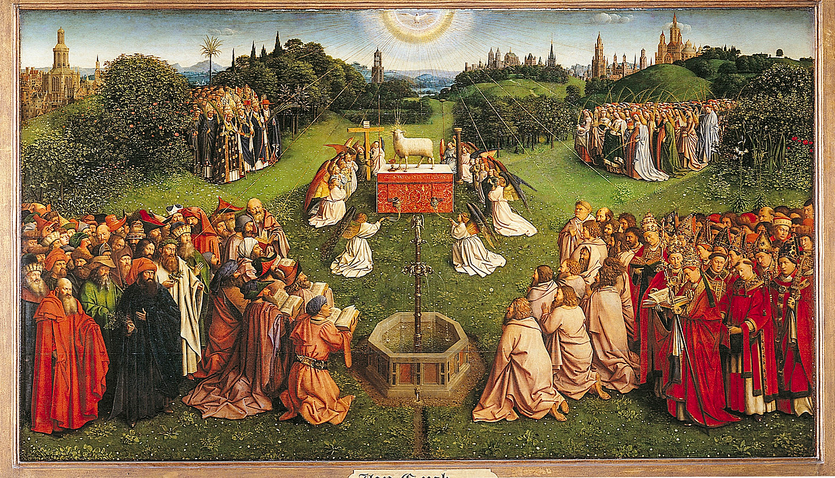

Slide 8
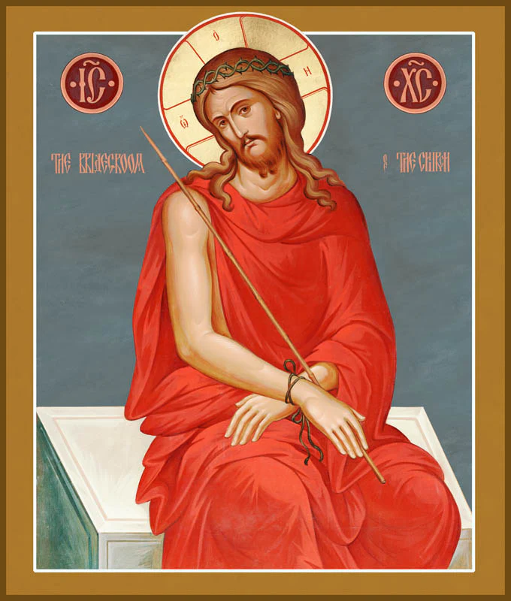
CHRIST AND HIS BRIDE, THE CHURCH
The theme of Christ as Bridegroom of the Church was prepared for by the prophets and announced by John the Baptist.
The Lord referred to himself as the “bridegroom.” The Apostle speaks of the whole Church and of each of the faithful, members of his Body, as a bride “betrothed” to Christ the Lord so as to become but one spirit with him. The Church is the spotless bride of the spotless Lamb. “Christ loved the Church and gave himself up for her, that he might sanctify her.” He has joined her with himself in an everlasting covenant and never stops caring for her as for his own body:
“The two will become one flesh. This is a great mystery, and I am applying it to Christ and the Church.” And the Lord himself says in the Gospel: “So they are no longer two, but one flesh.” They are, in fact, two different persons, yet they are one in the conjugal union, . . . as head, he calls himself the bridegroom, as body, he calls himself “bride” (CCC 796).

Slide 9
https://www.youtube.com/watch?v=JDBhaeus3Sg

Slide 10
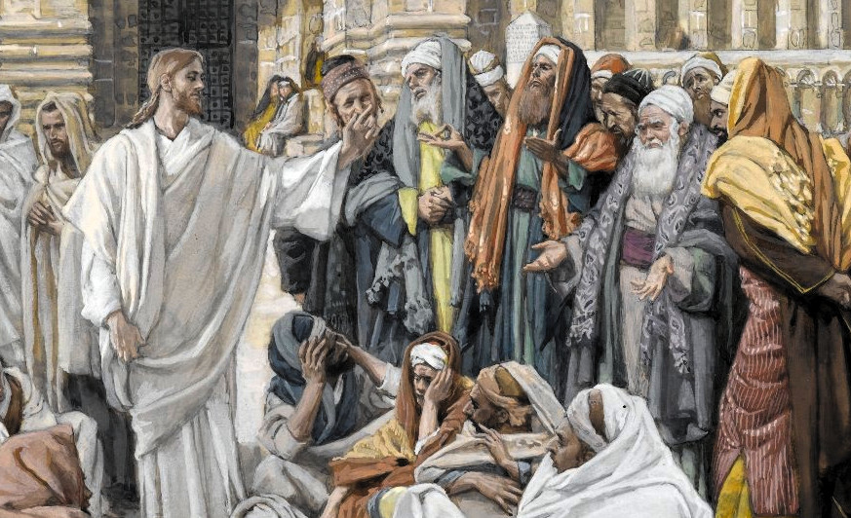
DIVORCE AND REMARRIAGE
Jesus unequivocally taught the indissolubility of marriage:
Some Pharisees approached him, and tested him, saying, “Is it lawful for a man to divorce his wife for any cause whatever?” He said in reply, “Have you not read that from the beginning the Creator ‘made them male and female’ and said, ‘For this reason a man shall leave his father and mother and be joined to his wife, and the two shall become one flesh’? So they are no longer two, but one flesh. Therefore, what God has joined together, no human being must separate. (Matthew 19:3-6)
St. Paul reinforces Christ’s teaching on marriage. “A wife should not separate from her husband and a husband should not divorce his wife.”

Slide 11
DIVORCE IS NOT A SIN
Many people divorce and for a variety of reasons such as infidelity, abuse, etc. And just because two people were married in the Church does not mean that God was a part of the decision for them to marry.
If a Catholic should seek a divorce, they should also obtain an ANNULMENT.
An annulment is a declaration that a marriage is invalid, and the reason can be rooted in one or more “grounds,” such as:
Fraud
Force
Fear
Past Conditions
Error of quality of a person
Grave lack of discretionary judgement
Willful exclusion of children
Etc.

Slide 12
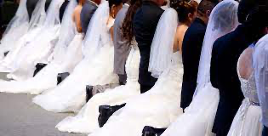
CONVALIDATION
Convalidation is a way of making a legal union a sacramental one.
If a couple was married outside of the Church, they can request a Convalidation.
This happens most often during things like the RCIA process, or after a divorce/remarriage/annulment situation.
This process does require some paperwork,
but it can be as simple as a quiet ceremony
With a couple of witnesses, as celebratory as
a full-blown wedding, or even done as part
of a parish community ceremony with a
group of people.

Slide 13
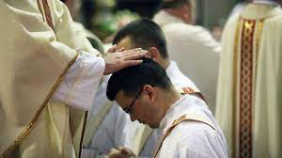
HOLY ORDERS
From the moment of Jesus’ conception in the womb of Mary until his Resurrection, he was filled with the Holy Spirit. In biblical language, he was anointed by the Holy Spirit and thus established by God the Father as our high priest. As Risen Lord, he remains our high priest.
While all of the baptized share in Christ’s priesthood, the ministerial priesthood shares this through the Sacrament of Holy Orders in a special way.
Ordination to the priesthood or deaconate is always a call and a gift from God. This call from God can be recognized and understood from the daily signs that disclose his will to those in charge of discerning the vocations of candidates.
“Here I am, send me.” (Isaiah 6:8)

Slide 14
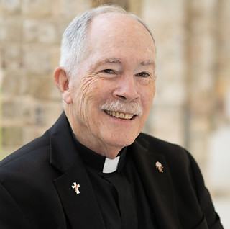
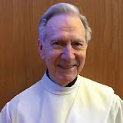
DEACONS
The title deacon comes from the Greek word diakonia meaning “servant.” A deacon has a special attachment to the bishop in the tasks of service and is configured to Christ, the Deacon—or Servant—of all (cf. CCC, nos. 1569-1570).
“There are two degrees of ministerial participation in the priesthood of Christ: the episcopacy and the presbyterate. The diaconate is intended to help and serve them” (CCC, no. 1554).
Deacons receive the Sacrament of Holy Orders from a bishop.
Deacons may baptize, proclaim the Gospel, preach the homily, assist the bishop or priest in the celebration of the Eucharist, assist at and bless marriages, and preside at funerals. They dedicate themselves to charitable endeavors, which was their ministerial role in New Testament times.
The deaconate may also be conferred on both married and unmarried men. However, a man must be married before becoming what is called a “permanent deacon.”
Seminarians preparing for priesthood have always been ordained as what is called a “transitional deacon” before ordination to priesthood

Slide 15
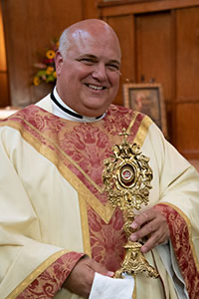
PRIESTS
By ordination, “priests are united with the bishops in dignity and at the same time depend on them in the exercise of their pastoral functions; they are called to be the bishops’ prudent co-workers” (CCC, no. 1595).
With the bishop, priests form a presbyteral (priestly) community and assume with him the pastoral mission for a particular parish.
The bishop appoints priests to the pastoral care of parishes and to other diocesan ministries. The priest promises obedience to the bishop in service to God’s people.
Clerical celibacy is mandated for all clergy (except the permanent deaconate).
Priests may baptize, proclaim the Gospel, preach the homily, preside at weddings and funerals, hear Confessions, as well as administer the Sacrament of the Anointing of the Sick. Along with deacons and the bishop, they are an “ordinary” minister of Holy Communion.
“Monsignor” is a special, honorary title given to priests usually because of their great service to a bishop or diocese. It is a form of the Italian monsignore, meaning "my lord.”

Slide 16
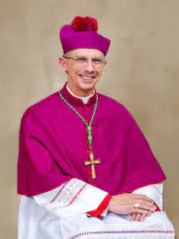
BISHOPS
Bishops receive the fullness of the Sacrament of Holy Orders and become successors of the Apostles. They belong to the college of bishops (episcopacy) and serves as the visible head or pastor of the local church (diocese).
Bishops have care and concern for the apostolic mission of all the churches in union with and under the authority of the Pope—the head of the college of bishops, the Bishop of Rome, and the successor of St. Peter.
Bishops may do everything a priest or deacon can do, as well as Confirm members of the body of Christ. A Bishop, however, can appoint a priest as his delegate for Confirmations – such as at the Easter Vigil when the Bishop cannot be present at every church. If a priest celebrates a Confirmation, he must write and ask for the permission (delegation) of the Bishop.
In order to be a Bishop, a person must be at least 35 years old and must have been a priest for at least 5 years. He is to possess a doctorate, or a pontifical licentiate degree, in Sacred Scripture, Theology, or Canon Law. If not, he must be at least truly expert in one of these fields. Most bishops are bi- or multi-lingual.
Potential Bishops are selected and submitted to the Apostolic Nuncio, reviewed, reported to the prefect of the Congregation of Bishops, and then decided on (appointed) by the Holy Father himself.

Slide 17
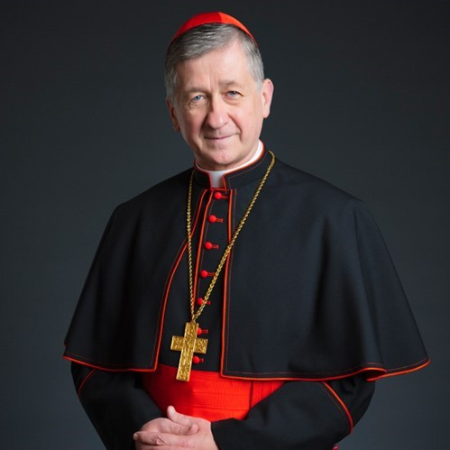
CARDINALS
A Cardinal is a senior member of the clergy of the Catholic Church.
Cardinals are created by the pope and typically hold the title for life. Collectively, they constitute the College of Cardinals.
Cardinals are leading bishops and members of the College of Cardinals. Their biggest duty is participating in the Papal Conclave, that is, voting for the new Pope. Most have additional duties including missions within the Roman Curia, governmental body of the Holy See.
There are 16 United States Cardinals.
6 lead Archdioceses – Chicago, Galveston-Houston, New York, Washington, San Diego, Boston, and Newark
3 serve in another capacity – Patron, Prefect, Archpriest
6 are retired – Archbishop Emeritus
Cardinal Blasé Cupich, Archdiocese of Chicago

Slide 18
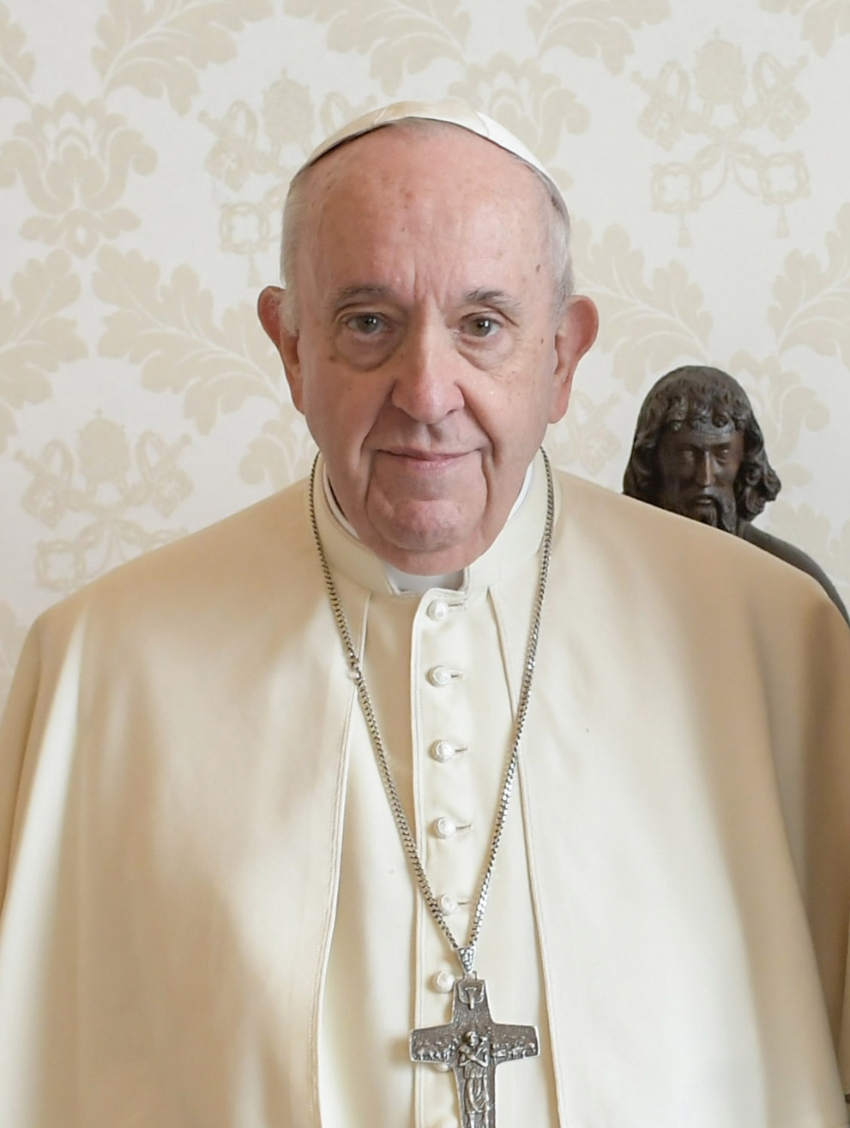
THE HOLY FATHER – THE POPE
The highest honor a member of the clergy can receive is to be elected as the leader of the Catholic Church. The Pope is elected by cardinals following the death or resignation of a Pope. There is no limit to how many years a Pope may hold his office.
The office of the Pope is referred to as the papacy. The Pope rules the Catholic Church in a very similar way to a king would a country, and he is the head of state for the Vatican City. The Roman Curia (you might remember them to be Cardinals) help the Pope to complete his duties.
Pope Francis (born Jorge Mario Bergoglio)
Newly elected popes much choose a regnal name, many choose to honor the names of previous popes. Each pope chooses his name in reflection of a saint he feels a strong connection to. Catholics believe the pope is infallible when speaking in ex cathedra (from the chair), and that God will not allow his followers to be misled by having him make a wrong statement when the criteria for ex cathedra are met.
Only a small number of popes have ever resigned or been deposed from office. The most recent was Pope Benedict XVI who, with great humility, resigned with the awareness and consciousness of “no longer being able to carry out the ministry with the strength that it requires.” He is now “Pope Emeritus.”

Slide 19
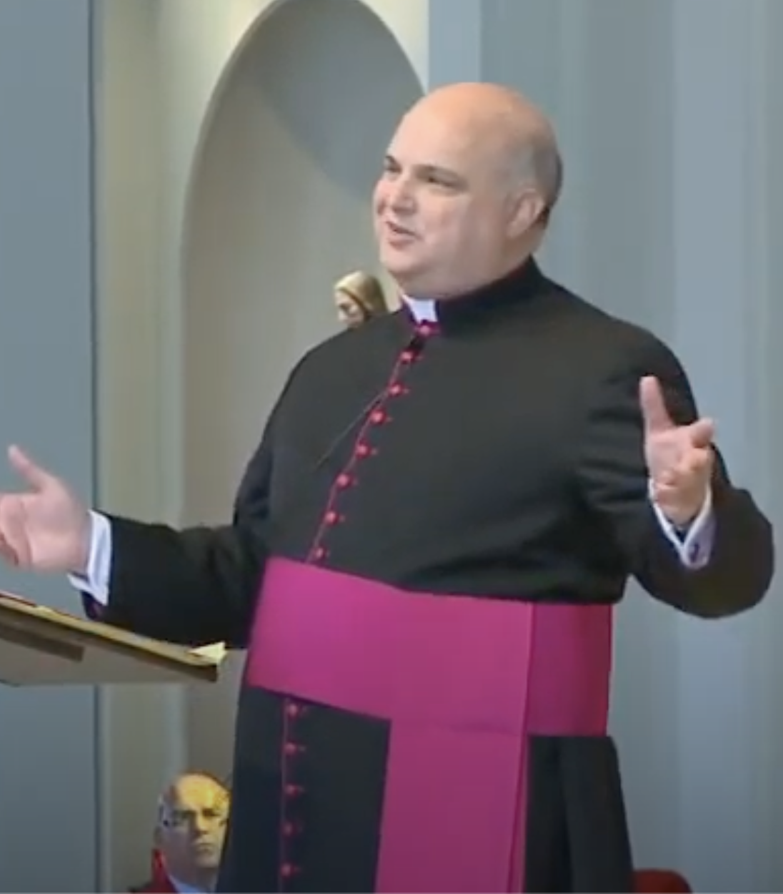
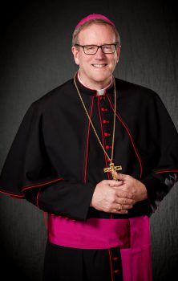
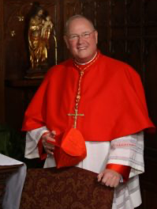
WHAT DO ALL THE COLORS MEAN?
CASSOCK – A full-length garment, usually black, and sometimes trimmed in a color designating office/rank (It’s a “work uniform” not a dress outfit!)
ZUCCHETTO – The skull cap that a bishop or cardinal wears
BIRETTA (a hat with 3 or 4 stiffened corners worn as part of liturgical dress)
PECTORAL CROSS – The large cross that a bishop or cardinal wears
MONSIGNORS
Purple / Magenta
BISHOPS
Amaranth Red / Fuschia
CARDINAL
Scarlet / Red

