Slide 1
RCIA: Sacred Scripture & Tradition

Slide 2
OPENING PRAYER
COME HOLY SPIRIT
Come Holy Spirit, fill the hearts of your faithful
and kindle in them the fire of your love.
Send forth your Spirit and they shall be created.
And You shall renew the face of the earth. O, God, who by the light of the Holy Spirit,
did instruct the hearts of the faithful,
grant that by the same Holy Spirit
we may be truly wise and ever enjoy His consolations,
Through Christ Our Lord, Amen.

Slide 3
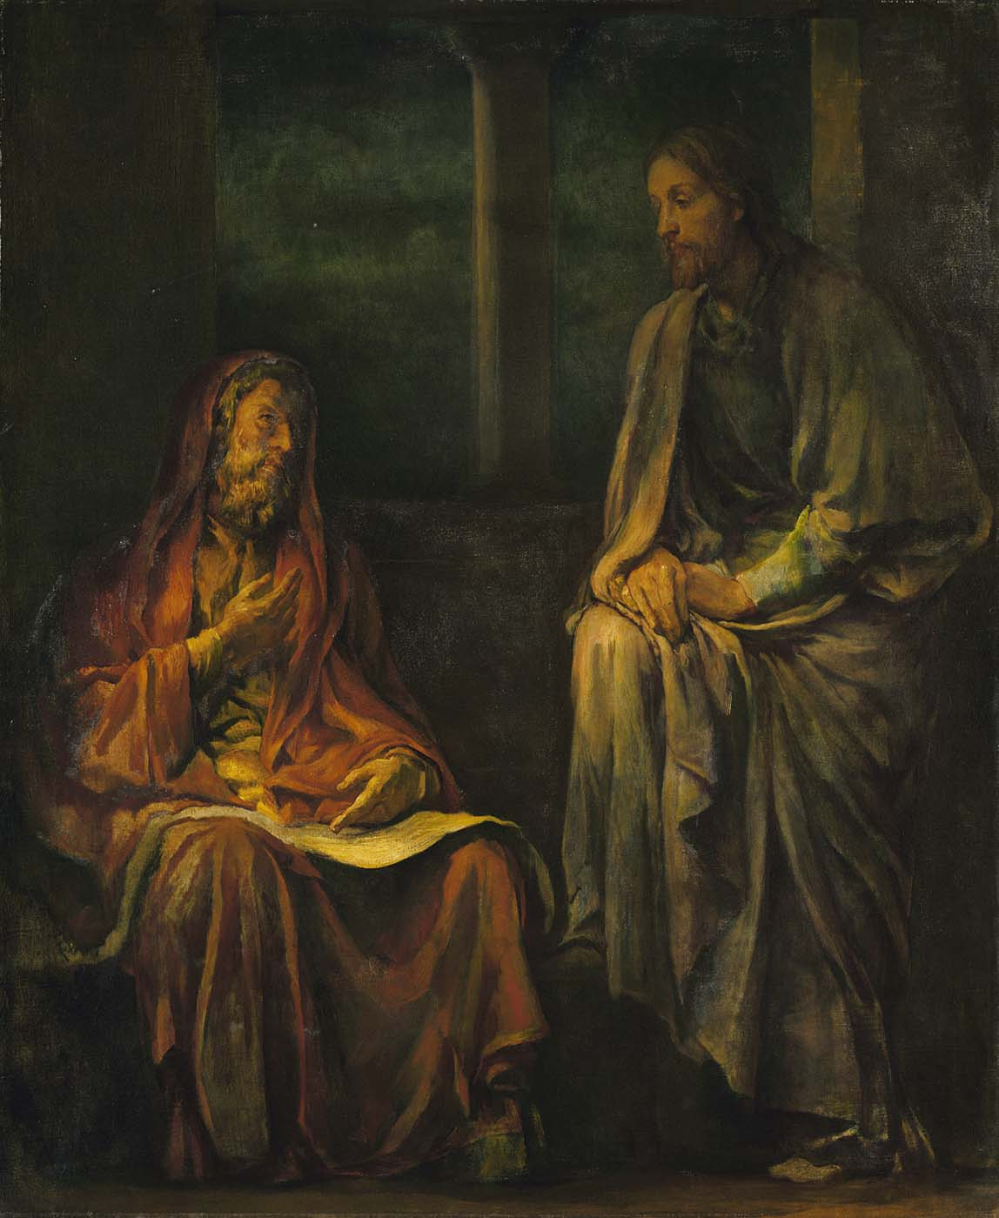
ST. NICODEMUS
Nicodemus was a Pharisee and an important first-century Jew.
Pharisee = a member of an ancient Jewish sect, distinguished by strict observance of the traditional and written law, and commonly held to have pretensions to superior sanctity. (can imply a self-righteous person; a hypocrite)
We know from John’s Gospel that Nicodemus went to Jesus at night—secretly—to better understand his teachings about the kingdom. (The first RCIA!)
Later, he spoke up for Jesus at the time of his arrest and assisted in Jesus’ burial.
Feast Day is August 31

Slide 4
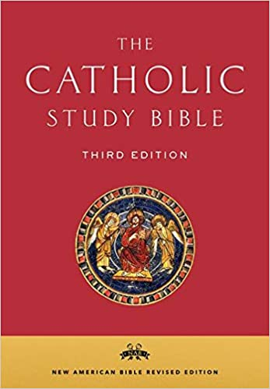
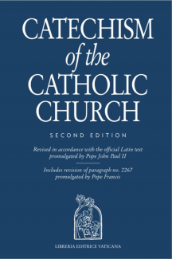
BIBLES & CATECHISMS

Slide 5
… who wills everyone to be saved and to come to knowledge of the truth … (1 Tim 2:4)
In the beginning was the WORD, and the Word was with God, and the Word was God. … And the Word became flesh and made his dwelling among us, and we saw his glory, the glory as of the Father’s only Son, full of grace and truth. (John 1:1-14)
… indeed, the WORD of God is living and effective, sharper than any two-edged sword, penetrating even between soul and spirit, joints and marrow, and able to discern reflections and thoughts of the heart. (Heb 4:11-12)
… Know this first of all, that there is no prophecy of scripture that is a matter of personal interpretation, for no prophecy ever came through human will; but rather human beings moved by the holy Spirit spoke under the influence of God. (2 Pt 1:19-21)
SACRED SCRIPTURE
A gift of God (1 Tm 2:4)
The Good News of salvation (Jn 1:1-14)
The authentic Word of God (Heb 4:11-12)
Interpretation of Scripture (2 Pt 1:19-21)

Slide 6
SACRED TRADITION
God the Father reveals to use who he is and what his plan is
Jesus Christ made the Father’s plan effective
The Holy Spirit guides and guards the Church’s teaching in every age
Sacred Scripture – the written portion of the Tradition, uniquely inspired by the Holy Spirit
Sacred Tradition – the inerrant teaching and interpretation of the Church, guarded by the Holy Spirit; handed on by the Apostles, eminently preserved in the Scriptures, remembered by the Church, and interpreted authoritatively by the Church's magisterial gift
Deposit of Faith - the truth of God's Revelation as expressed in Sacred Scripture, which is the inspired and written Word of God, and Sacred Tradition, which is the Word of God as taught and transmitted through the teaching authority of the Church
He redeemed us
He established his Church
He gave his Apostles his teaching authority
The Great Commission (Mt 28:16-20)
Tradition – the fullness of revelation, both orally and in writing
Magisterium – The Teaching Office of the Church, authentically interprets the Word of God as the servant of God’s Revelation

Slide 7
Sola Scriptura
Unbiblical, Unhistorical, Unworkable
Splinters– Different Denominations
What are some examples from this life that demonstrate that the Bible alone is not enough?
Revelation = “Unveiling” of something
The Church’s Authority Comes From …
1 - Sacred Scripture
2 - Sacred Tradition
3 - The Magisterium

Slide 8
CLOSING PRAYER Adapted from Psalm 119
LORD, we ask you to reveal who you are to us a little more each day, so that we can continue to grow in our relationship with you by knowing more about you.
We ask that as we know more about you, we would be courageous in living out the Truth of the Gospel.
Teach us, O LORD, the way of thy statutes.
Lead us in the path of thy commandments.
Thy word is a lamp to my feet and a light to my path.
Amen.

