Slide 1
Lent

Slide 2
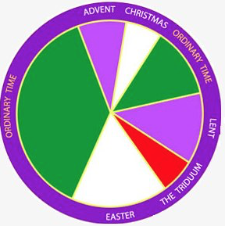
Liturgical Calendar

Slide 3
What is Lent?
Period of introspection, fasting, penance, and prayer leading to Easter
“Lent is a period of spiritual ’combat’ which we must experience alongside Jesus, not with pride and presumption, but using the arms of faith: prayer, listening to the word of God and penance. In this way we will be able to celebrate Easter in truth, ready to renew the promises of our Baptism.”
- Pope Benedict XVI

Slide 4
How did the Lenten observance come about?
Developed in the 4th Century:
- Time of intense preparation for those catechumens preparing to receive the Sacraments of Initiation (Baptism, Confirmation, Eucharist) at Easter
- This preparation was seen as beneficial for ongoing conversion for those Christians who had fallen back into serious sin after Baptism
Therefore, the community at large accompanied the catechumenates on their journey and prepared to renew their baptismal vows at Easter

Slide 5
Why is it called Lent?
The word Lent is derived from the Middle English word lenten, meaning springtime – the time of lengthening days
Why forty days?
- The length of Jesus’ fasting and temptation in the desert (Luke 4:1-13)
- Moses stayed on the mountain with the Lord 40 days (Exodus 24:18)
- Elijah traveled 40 days to Horeb to encounter the Lord (Kings 19:8)
- Israelites wandered and were tested in the wilderness for 40 years

Slide 6
Each year the Church observes Lent where we, like Israel and our Lord, are tested. We participate in abstinence, times of fasting, confession and acts of mercy to strengthen our faith and devotional disciplines. The goal of every Christian is to leave Lent a stronger and more vital person of faith than when we entered. ~Catholic Online

Slide 7
Three Pillars of Lenten Observance: Prayer, fasting, and almsgiving
Prayer
More time given to prayer during Lent should draw us closer to the Lord.
We might pray especially for:
- the grace to live out our baptismal promises more fully.
- the elect who will be baptized at Easter and support their conversion journey by our prayer.
- those who will celebrate the Sacrament of Reconciliation with us during Lent that they will be truly renewed in their baptismal commitment.

Slide 8
Three Pillars of Lenten Observance: Prayer, fasting, and almsgiving
“What are you giving up for Lent this year?”
Fasting – Why do we fast?
Small sacrifice: Set aside a lesser good for the highest good – God, the creator/giver of all good things.
- Dying to self - Our world: emphasis on instant gratification
Reminds us to keep God at the center / Keeps our passions properly ordered
Reminds us that love entails sacrifice
- Creates space to draw closer to Jesus. For example, giving up something that clutters our quiet time (tv show, social media, video games, web surfing)
Changes in Liturgy: We don’t sing the Gloria or say / sing the word “Alleluia”
Minimal / simple decoration in Church

Slide 9
Three Pillars of Lenten Observance: Prayer, fasting, and almsgiving
Fasting from food:
- Eating is a daily necessity
- Fasting is a way to treat a daily need very intentionally
Aid to prayer: hunger pangs remind us of our hunger for God.
Reminds us of the suffering and poverty in our world today - should lead us to greater efforts to alleviate that suffering.
Linked to living out our baptismal promises. By our Baptism, we are charged with the responsibility of showing Christ's love to the world, especially to those in need.

Slide 10
Three Pillars of Lenten Observance: Prayer, fasting, and almsgiving
Days of Fasting: Ash Wednesday and Good Friday
-One full meal with two smaller snacks that when combined would be less than a meal. Only coffee, tea, and water permitted between meals
-Ages 18-60 (Excludes pregnant women / health conditions)
Abstinence: Refers to not eating meat
Refrain from eating meat on Fridays during Lent. Meals on Fridays should be simpler meals (Abstaining from meat but going out for lobster is missing the point!)
Note: Every Friday is a “mini” Good Friday and every Sunday is a “mini” Easter.

Slide 11
Three Pillars of Lenten Observance: Prayer, fasting, and almsgiving
Almsgiving
Almsgiving, is also linked to our baptismal commitment. It is a sign of our care for those in need and an expression of our gratitude for all that God has given to us. Works of charity and the promotion of justice are integral elements of the Christian way of life we began when we were baptized.
Time – Talent - Treasure

Slide 13
Liturgical Celebration of Lent
When does Lent begin and end?
Lent begins on Ash Wednesday and ends on Holy Thursday.
What is the liturgical color of Lent:
Purple
Laetare (“Rejoice”) Sunday – Fourth (middle) Sunday in Lent.
Hope and encouragement as we progress through penitential season toward Easter. Rose vestments frequently worn

Slide 14
Ash Wednesday
Ash Wednesday is the first day of Lent (Not a Holy Day of Obligation, but encouraged!)
It is, however, one of the mandated days of fasting and abstinence
Ashes are sprinkled to the top of the head or applied to the forehead in the sign of the cross
”Remember you are dust and to dust you shall return”
”Turn away from sin and be faithful to the Gospel”
The ashes for Ash Wednesday are made from the blessed palm branches from the previous Palm Sunday. They are sprinkled with Holy Water and incensed prior to distribution
All are invited to receive ashes
https://youtu.be/hPTcMWpHfKk

Slide 15
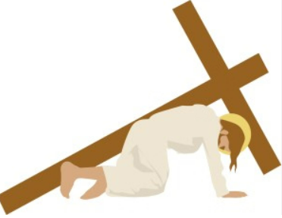
Stations of the Cross
A “mini-pilgrimage” traditionally prayed during Lent
Devotion developed over time
Current form: Fourteen “Stations”
Walk and reflect deeply on the Passion; Various reflections available
You can find Stations in the Cross in the vast majority of Catholic churches. At SPX, the Stations are hung in the nave of the church as well as in the chapel

Slide 16
Sacrament of Reconciliation
Precept of the Church: All Catholics must receive the Sacrament of Reconciliation, at a minimum, once per year. Given the penitential nature of the Lenten season, it is a very appropriate time during the year to receive this Sacrament
Can receive the Sacrament from any validly ordained priest
Confession times vary by parish
At SPX:
During Lent: Every Friday 4-5 pm
All year (including Lent): Every Saturday 4-4:45, or by appointment

Slide 17
Palm Sunday
– Last Sunday of Lent
Commemorates Jesus’ triumphant arrival into Jerusalem
In Scripture, people placed palms on the ground before Jesus in homage
We carry palms in Mass, which are then blessed. This year’s palms become the ashes for next year’s Ash Wednesday
Also called Passion Sunday – Frequently the Gospel reading is the Passion narrative
Red vestments are worn

Slide 18
Holy Week
Monday
Tues – Chrism Mass
All Priests of the Diocese come together for Mass with the Bishop. All of the holy oils used in liturgies throughout the year are consecrated at this Mass
Wed – “Spy Wednesday” – Judas’ betrayal
Thurs – “ Maundy Thursday”: Mass of the Lord’s Supper
Institution of the priesthood
Institution of the Eucharist
Fri – Good Friday: Stations of the Cross at 3pm; Veneration of the Cross 7pm
Note: Good Friday is the ONLY day in which No Mass is celebrated - ANYWHERE
Saturday – Holy Saturday; Easter Vigil
Easter Sunday

Slide 19
Triduum
The Triduum
Lent is followed by the Triduum – the summit of the Liturgical Year. Though chronologically three days (Holy Thursday through the evening of Easter Sunday), they are liturgically one day unfolding for us the unity of Christ’s Paschal Mystery.
Mass of the Lord’s Supper
Good Friday of the Lord’s Passion
Mass of the Resurrection of the Lord
Red vestments are worn

Slide 20
Easter Vigil
Sacraments are received at the very first celebration of Easter!
Not just at St. Pius – in the church universal!
Fruits of our evangelization, bringing souls to Christ!
All Catholics renew Baptismal promises
Vigil – begin in darkness, moving to light
Beauty
Incense, music, candlelight
More Scripture is proclaimed
Exultet

Slide 21
Sacraments and sin
God desires to dwell in us – to be in a “State of Grace” – to be in friendship with God, to have His life within us
Sin
Voluntary choice against God’s teaching. Voluntary: you can’t sin on accident
Affects our relationship with God and with others
We can sin in big and small ways (Venial v Mortal)
Small sins can lead to big sins
Habituation, rationalization – important to form our conscience
Plan for salvation
God didn’t take away our free will
Therefore wanted to create a path for us to Him
Sacraments: visible signs instituted by Christ to give us Grace and to make us holy
Through the Sacraments, God’s Grace is poured into us

Slide 22
Liturgical Calendar
What is Palm Sunday?
– Last Sunday of Lent
Commemorates Jesus’ triumphant arrival into Jerusalem
In Scripture, people placed palms on the ground before Jesus in homage
Also called Passion Sunday – Frequently the Gospel reading is the Passion narrative
Red vestments are frequently worn
The Triduum
Lent is followed by the Triduum – the summit of the Liturgical Year. Though chronologically three days (Holy Thursday through the evening of Easter Sunday), they are liturgically one day unfolding for us the unity of Christ’s Paschal Mystery.
Mass of the Lord’s Supper
Good Friday of the Lord’s Passion
Mass of the Resurrection of the Lord
Red vestments are worn
- Easter: The Triduum culminates in Easter, an Octave ( 8-day) celebration beginning the full Easter season which ends on Pentecost
Easter: White or gold vestments

Slide 23
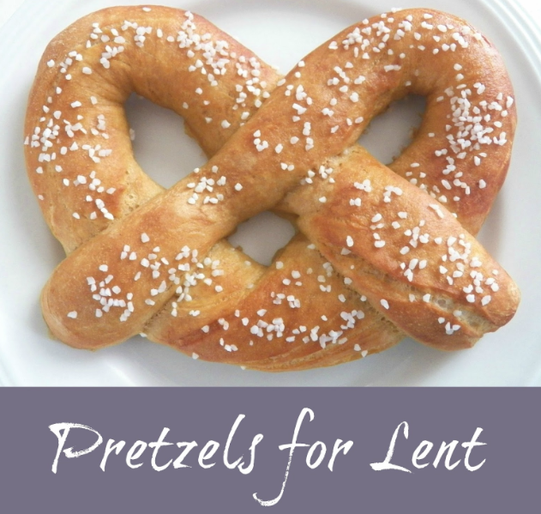
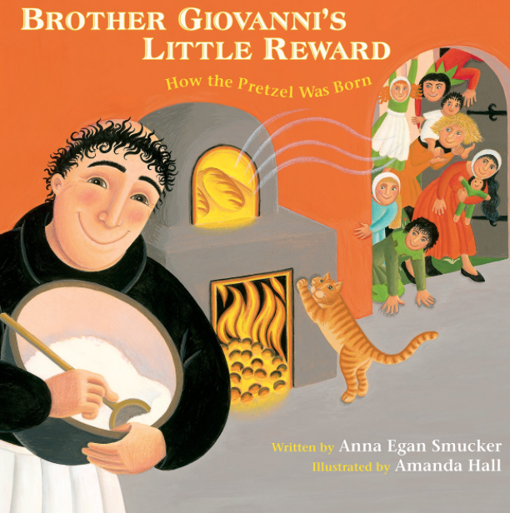
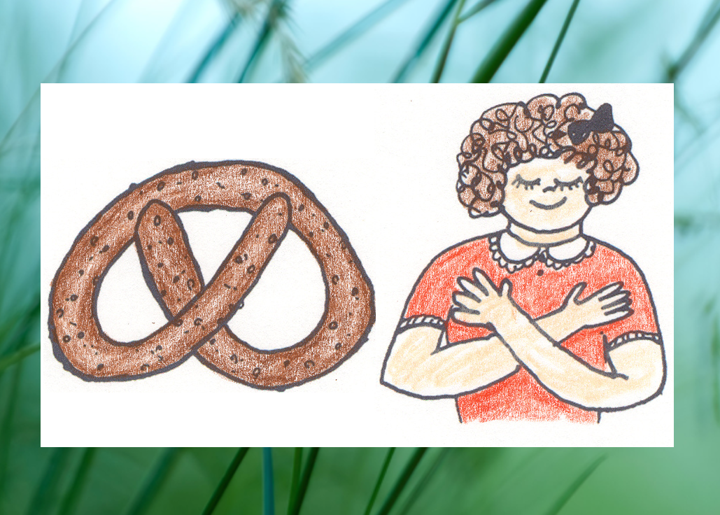
History of the Pretzel

Slide 24
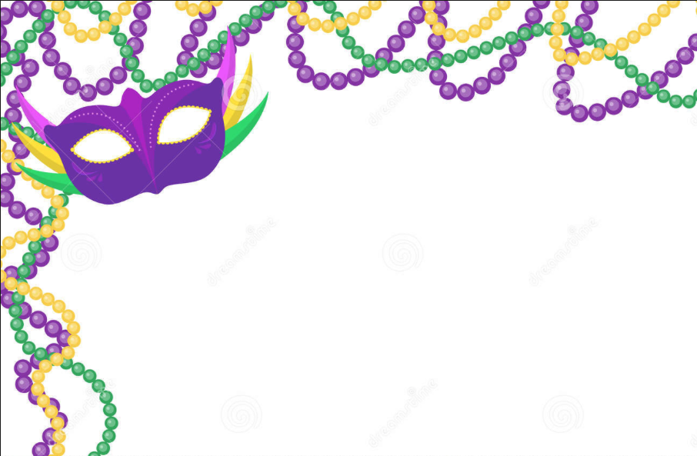
“Laissez les bons temps rouler…..”
Mardi Gras or ”Fat Tuesday”
Evening before Ash Wednesday
Partake of rich foods and treats before entering the season of fasting, abstinence, confession and penance
Carnival is derived from Latin ”carne vale” which means “farewell to meat” or “farewell to flesh
Colors of Mardi Gras are the colors of our Liturgical Calendar!

Slide 25
Fun Food Facts:
The McDonald’s Fish Fillet sandwich was invented in 1962 by Lou Groen, a franchise holder in Cincinnati, Ohio. His restaurant was located in a predominantly Catholic neighborhood. Pre-Vatican II, abstinence from meat applied to all Fridays, and he came up with a popular way to combat the drop in hamburger sales on Fridays!

Slide 26
Why do we have a liturgical calendar?
Purpose: To unify the faithful in orienting our days around the person of Jesus
CCC 1194: “The Church, ‘in the course of the year…unfolds the whole mystery of Christ from his Incarnation and Nativity through his Ascension, to Pentecost and the expectation of the blessed hope of the coming of the Lord”
“In the absence of the Liturgical Calendar we will structure our lives around whatever shouts at us most loudly” www.osv.com

Slide 27
What is the liturgical calendar?
Schedule established for the Roman Catholic Church universal
Seasons: direct our focus to a particular part of Jesus’ life, ministry, mission
Seasons visually identified by liturgical colors for clerical vestments and church decorations
Scripture readings for every Roman Catholic Mass throughout the world
Calendar of Feast days (Sts. Martha, Mary, and Lazarus, St. Patrick, Our Lady of Guadalupe) and Holy Days of Obligation (e.g. Immaculate Conception Dec. 8
Who are the saints?
Notes:
The Church year is structured around the life of Jesus. It pursues Him from the first signs of His coming in Advent to His birth at Christmas, to His trials in Lent, and death on Good Friday, to the wonders of His Easter Resurrection and Ascension, and finally glimpses a vision of Him enthroned as King in glory (Feast of Christ the King – 11/25/2018)

Slide 28
Liturgical Calendar
Lent
Triduum
Easter
…stay tuned…

