Slide 1
RCIA Holy Trinity – A God Who Is Love

Slide 2
26th Sunday in Ordinary Time Matthew 21:28-32
Jesus said to the chief priests and elders of the people:
“What is your opinion? A man had two sons. He came to the first and said, ‘Son, go out and work in the vineyard today.’ He said in reply, ‘I will not,’ but afterwards changed his mind and went. The man came to the other son and gave the same order. He said in reply, ‘Yes, sir,’ but did not go. Which of the two did his father's will?”
They answered, “The first.”
Jesus said to them, “Amen, I say to you, tax collectors and prostitutes are entering the kingdom of God before you. When John came to you in the way of righteousness, you did not believe him; but tax collectors and prostitutes did. Yet even when you saw that, you did not later change your minds and believe him.”

Slide 3
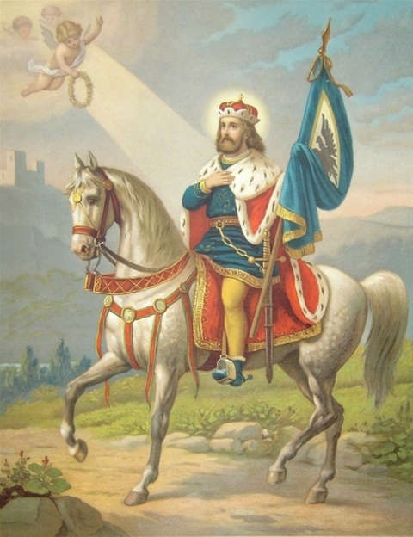
St. Wenceslaus
The life of Wenceslaus stands as an example of promoting Christian values in the midst of the political intrigue and the enticement of power which characterized 10th-century Bohemia (Czechoslovakia).
Hs father was a Catholic Duke and his mother a pagan Princess. During his youth, Wenceslaus received a strong religious education from Ludmilla, in addition to the good example of his father. He maintained a virtuous manner of living while attending college near Prague, making significant progress both academically and spiritually. When his father died, he faced a spiritual and political crisis.
Power and rule were split and his mother and brother sided against the Church ruling one half, while Wenceslaus and his grandmother, his advisor, ruled the other half. His mother carried out a plot to kill Ludmilla, having her strangled in her private chapel. St. Ludmilla's liturgical feast day is Sept. 16.
Wenceslaus also faced the threat of invasion from abroad, when he sought to avoid a war by challenging another Bohemian Prince in single combat. Two angels are said to have appeared, deflecting the javelin thrown at Wenceslaus and immediately inspiring the prince to drop to his knees in surrender.
Wenceslaus' brother sought to appear as a peacemaker, tricking the king to his realm for a celebration. When Wenceslaus was praying in a chapel during the visit, Boleslaus' henchmen attacked and wounded him. Boleslaus himself delivered the final blow, killing his brother by running him through with a lance. St. Wenceslaus died on Sept. 28, 935.
Although his death resulted primarily from political upheaval, Wenceslaus was hailed as a martyr for the faith, and his tomb became a pilgrimage shrine. He is hailed as the patron of the Bohemian people and of the former Czechoslovakia.

Slide 4
https://www.youtube.com/watch?v=EoFNxugeEOo

Slide 5
WHAT CATHOLICISM IS NOT
Polytheism = a belief system based on the belief in multiple deities. A prominent example is Hinduism.
Pantheism = belief that the universe is equivalent to god, and that there is no division between a creator and the substance of its creation.
Monothelitism = the doctrine that Jesus Christ had two natures but only one will; essentially denying all reality to the human nature of Christ at the Incarnation
OTHER TERMS …
Gnosticism = emphasizes personal spiritual knowledge above orthodox teachings, traditions, and authority of traditional religious institutions
Agnostic = a person who believes that nothing is known or can be known of the existence or nature of God or of anything beyond material phenomena; a person who claims neither faith nor disbelief in God
Atheist = a person who disbelieves or lacks belief in the existence of God or gods
One God
Blessed Trinity
Discussion

Slide 6
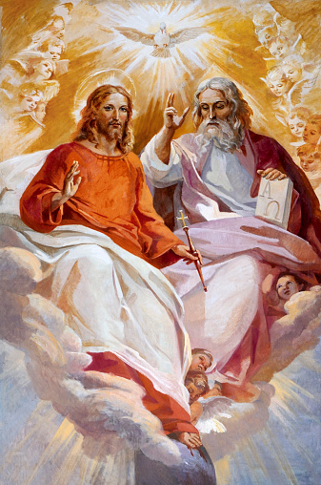
WHAT CATHOLICISM IS
Monotheism = a belief system based on the belief in a single deity. Religions that are considered examples of monotheism include Judaism, Christianity, and Islam.
Dyothelitism = the theological doctrine that in Christ there were two wills, the human and the divine; from Greek δυοθελητισμός "doctrine of two wills”; promoted by St. Ambrose of Milan
One God
Blessed Trinity
Discussion

Slide 7
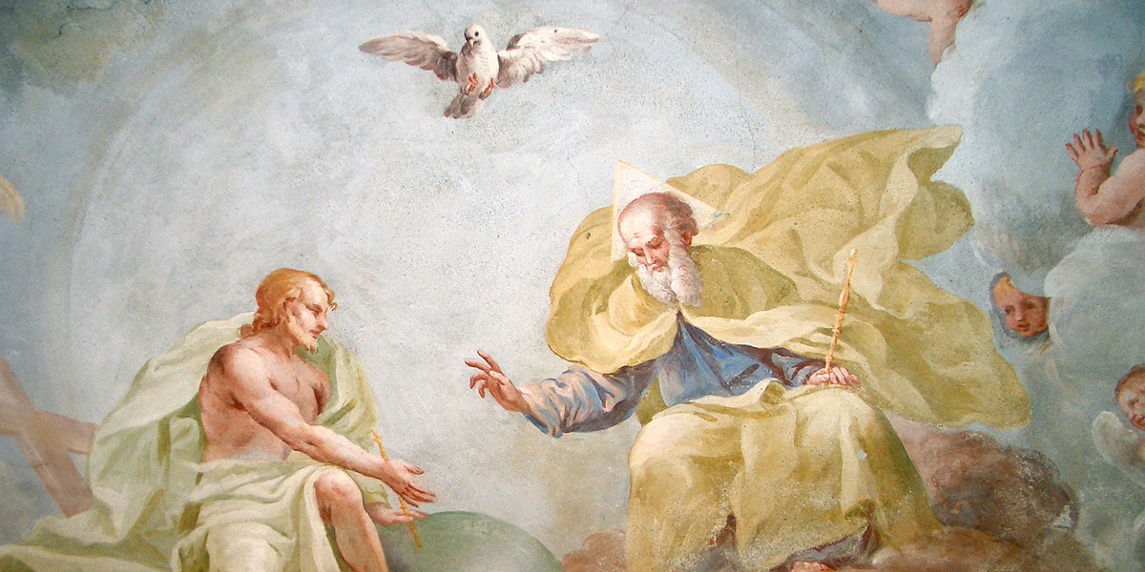
WHO are you?
Lindsay
WHAT are you?
Human, Mother, Woman, Sister
God is __________.
One God
Blessed Trinity
Discussion

Slide 8
“Begotten, Not Made”
to beget vs. to create
Man begets man, beavers beget beavers
Man makes statues, beavers make dams
Whatever God begets is God.
Whatever man begets is man.
“Consubstantial”
Jesus Christ is of the same state, or existence, as God
“Hypostatic Union”
Christ is one person in two natures – Divine & Human
Hypostasis means, literally, “that which lies beneath as a basis or foundation” or “the underlying or essential part of anything as distinguished from attributes (substance, essence, or essential principle)”
One God
Blessed Trinity
Discussion

Slide 9
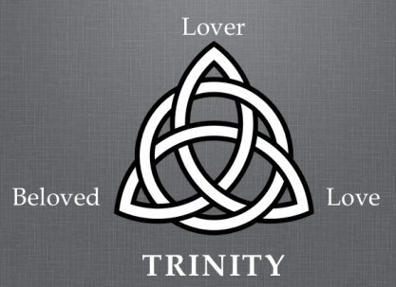
ST. AUGUSTINE explains …
THE MOSTY HOLY TRINITY
In the “Economic Sense” (understanding God through the human senses)
Imagine two married people in love –the lover and the beloved. You cannot see the love that passes between them (you see hands holding, couples’ kissing etc. which are signs of love but not love itself.)
One God
Blessed Trinity
Discussion
Using this imagery …
The LOVER = the Father
The BELOVED = the Son
The LOVE ITSELF = the Holy Spirit

Slide 10
https://www.youtube.com/watch?v=5l-Lv9tGQwI

Slide 11
Discuss with Table & Group
What do you think of when you call God “Father”? What does that title mean to you?
How would you describe Jesus, the second person of the Trinity, to other people in your life?
The gifts of the Holy Spirit are: wisdom, understanding, counsel, fortitude (courage), knowledge, piety (reverence), and fear of the Lord (wonder and awe). Which gift of the Holy Spirit do you need right now?
One God
Blessed Trinity
Discussion

Slide 12
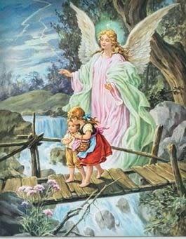
GUARDIAN ANGEL PRAYER
Angel of God,
My guardian, dear.
To whom God’s love
Commits me here.
Ever this day,
Be at my side.
To light and guard,
To rule and guide.
Amen.

