Slide 1
RCIA The Last Four Things: Death, Judgment, Heaven, & Hell Sacraments: Anointing of the Sick

Slide 2
In the Nicene Creed we state:
He will come again in glory
to judge the living and the dead
and his kingdom will have no end.
…
I look forward to the
resurrection of the dead
and the life of the world to come.

Slide 3
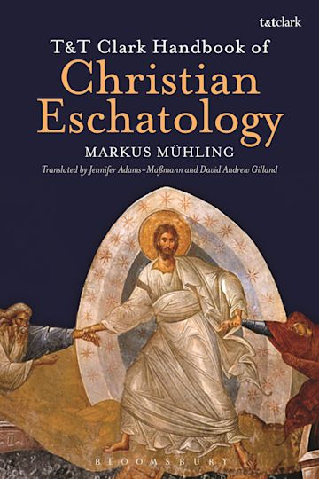
Eschatology
Another term for the study of the last four things is Eschatology
Comes from the Greek word eschatos which means “furthest” or “uttermost,” and so eschatology deals with the furthest or last things: death, judgment, heaven, hell, and purgatory
There are two main ways of focusing on eschatology:
(1) a Particular sense which deals with the last things of the individual: the person’s death and judgment, and their consequent reward or punishment
(2) There is also a Universal sense of eschatology that deals with everyone; this consists of Christ’s final coming, the Final Judgment, the resurrection of the body, and the new heavens and the new earth

Slide 4
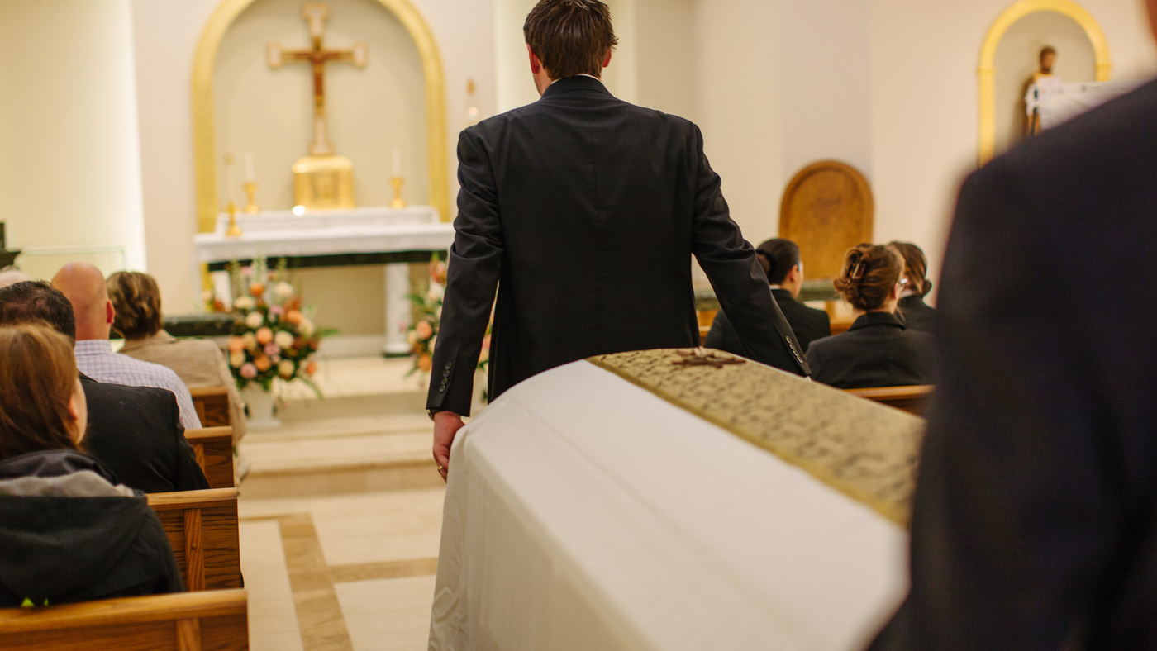
Death
Death – is the separation of the soul from the body
This is a theological definition as opposed to the medical definition of the irreversible loss of heart and lung functions or brain waves
Death is something which a human being will only experience once
Scripture says, “it is appointed for men to die once” (Hebrews 9:27)
There is no reincarnation
While death can seem natural, nevertheless, it is an experience of evil
Death is a consequence of sin; if our first parents would not have sinned, human beings would not have to die

Slide 5
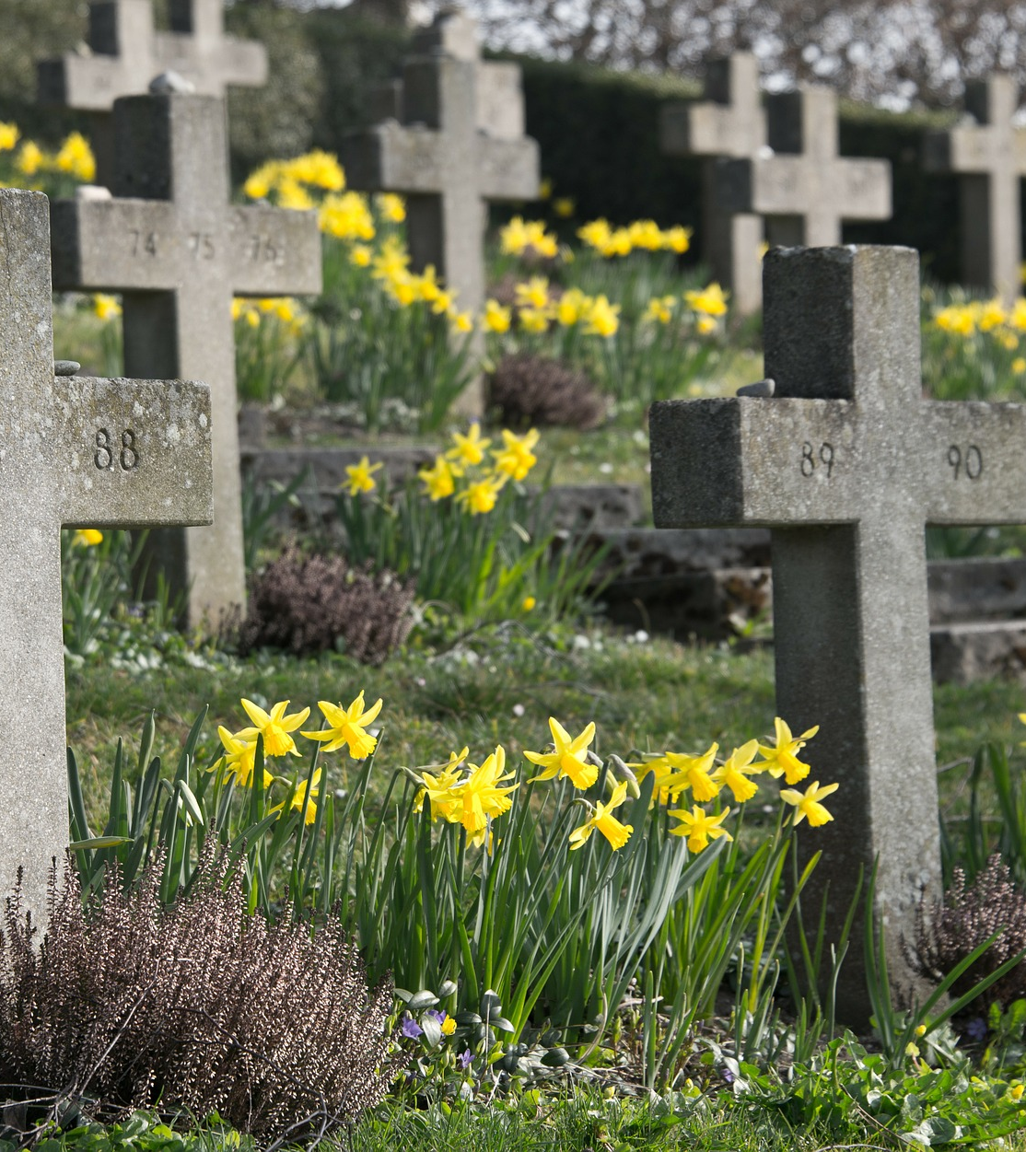
Christian Death
The light of faith, especially the paschal mystery of Christ, illuminates for us the mystery of death
Death has a new and positive meaning in Jesus Christ
Jesus transformed the curse of death into a great blessing
Death can now be the door to eternal life and resurrection
Christian death – is a death in Christ meaning that we die in a state of grace or friendship with God, meaning that one is without any mortal sin
When we die in Christ, we can lovingly offer the experience of our own death to the Father
A believer in Christ, following His example, is thus able to transform his own death into an act of obedience and love for the Father
“This saying is sure: if we have died with him, we will also live with him.” (2 Tim 2:11)

Slide 6
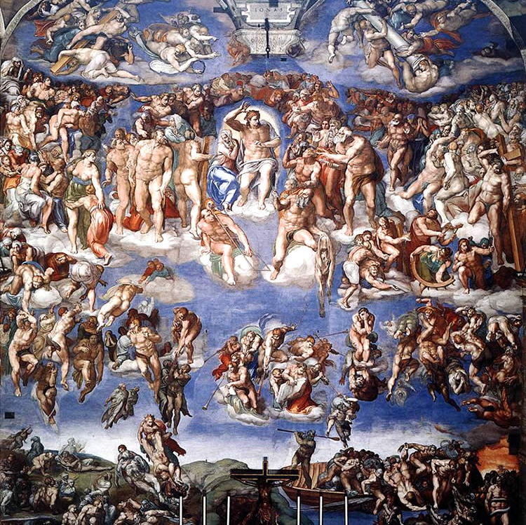
Judgment
There are two Judgments
The Particular Judgment
The Final Judgment
Christ is the Judge of the living and the dead
These two Judgments are closely bound together
The way we are judged at the Particular Judgment will be confirmed and completed at the Final Judgment

Slide 7
Particular Judgment
At the moment of death, the soul will go before the Divine Judge
The soul will be rewarded or punished based upon the way one lived during their life on earth
“So whether we are at home or away, we make it our aim to please him. For we must all appear before the judgment seat of Christ, so that each one may receive good or evil, according to what he has done in the body.” (2 Cor 5:9-10)
We will be judged by our faith and works
“At the evening of life, we shall be judged on our love.” –St. John of the Cross

Slide 8
Final Judgment
The Final Judgment will occur at the end of the world
“But of that day or that hour no one knows…” (Mk 13:32)
“The day of the Lord will come like a thief in the night” (1 Thess 5:2)
Christ will return in glory and raise all the dead
The body will then share in the eternal reward or punishment of the soul
We will understand God’s eternal plan and come to know the consequence of every good and evil action the human race has performed
The meaning of all of human history and the ultimate purpose of creation will be reveled

Slide 9
Hell
After the particular judgment, those who die in mortal sin and deny Christ are eternally lost in hell
“… it is better for you to enter life than … to go to Gehenna, to the unquenchable fire where their worm does not die, and the fire is not quenched.” (Mk 9:43-44)
Gehenna is a place in Israel where the Canaanites sacrificed children to their gods (The Valley of Ben Hinnom)
When the Israelites took over this territory, they made it into a landfill where trash was continually burned
2 Pains in hell
The worst is the pain of separation from God who alone can give the happiness for which man longs
Second is the pain of sense corresponding to one’s sins
God, while desiring “all to come to repentance” (2 Pet 3:9), nevertheless has created the human person to be free and responsible; and he respects our decisions; thus, a person chooses hell by mortal sin
The Church prays that none will be lost

Slide 11
Purgatory
After the particular judgment, a soul can be sent to purgatory which is the state of those who die in friendship with God but still need to be purified of venial sins or the remains of mortal sin
Purgatory is only for temporal punishment which is totally different from eternal punishment
It is both painful and joyful
Painful because the soul is undergoing purification and has not yet reached its goal, however not physical pain like we imagine
Joyful because the soul knows with certainty that it will reach ultimate good
Once the soul is purified it will enjoy the vision of God for all eternity
Our prayers and sacrifices, especially the sacrifice of the Mass, assists the purification of the souls in purgatory
Notes:
Practice of offering mass for the deceased
See the mass intentions in the bulletin

Slide 12
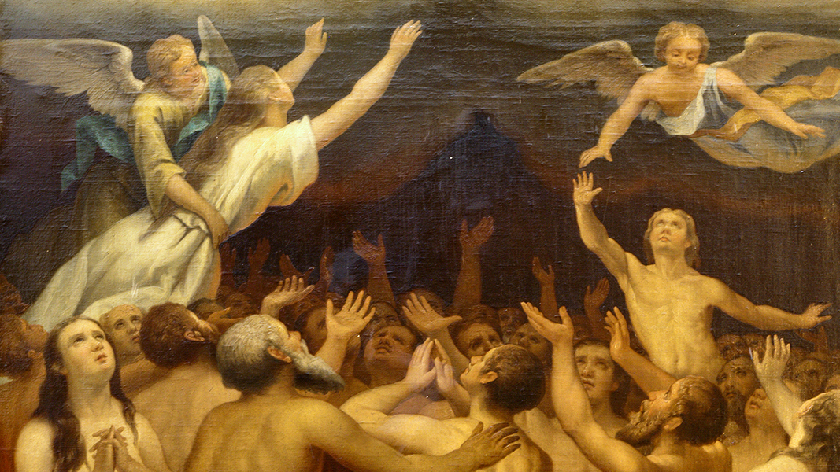
Scriptural Foundations of Purgatory
2 Maccabees 12:38-46; Lk 12:39-48
Mt 12:32 “And whoever says a word against the Son of man will be forgiven; but whoever speaks against the Holy Spirit will not be forgiven, either in this age or in the age to come.”
This indicates that forgiveness is possible in the age to come
Mt 18:21:35 “Then his lord summoned him and said to him, 'You wicked servant! I forgave you all that debt because you besought me; and should not you have had mercy on your fellow servant, as I had mercy on you?' And in anger his lord delivered him to the jailers, till he should pay all his debt. Also my heavenly Father will do to every one of you, if you do not forgive your brother from your heart.”
This parable is about the Kingdom of Heaven
The servant who did not show mercy is not cast into the outer darkness but is in jail until he pays everything back
Thus, we see there is a place where we pay back our debts

Slide 13
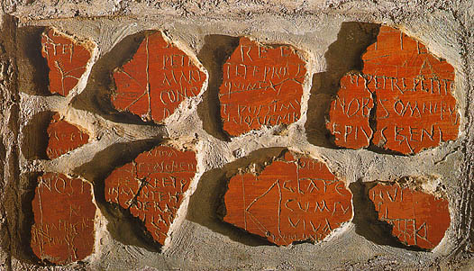
Purgatory in Tradition
Rome, Catacombs of Priscilla
Prayers for the dead
The custom of praying for the dead goes back to the 100s
Tertullian (160-220) says that this custom of prayer for the dead was received from tradition
The catacombs contain references to the need for prayers for the deceased
No one ever challenged prayer for the dead until Arius in the 4th century
State of Purification
St. Cyprian (200-258) said that the debt of punishment remains if one’s penance is not complete
St. Augustine (354-430) speaks of a “corrective fire” and “purgative fire”
The Church defined the doctrine of purgatory at the councils of Lyon (1274), Florence (1438–1445), and Trent (1545–63)
Inscriptions from the catacombs

Slide 15
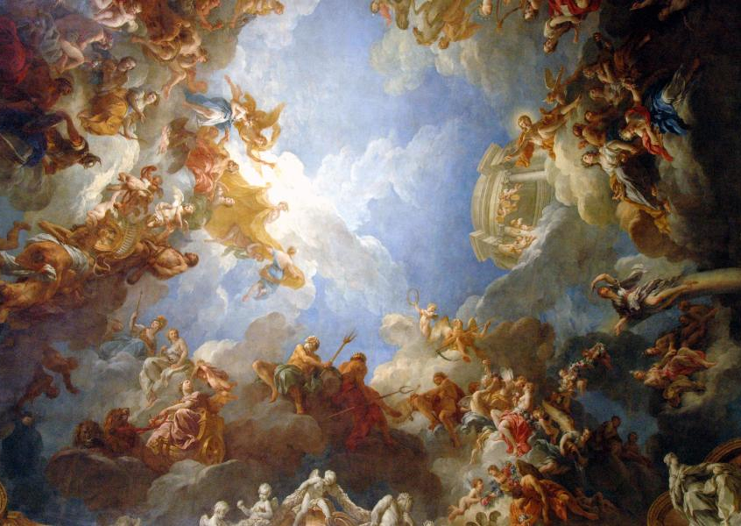
Heaven
After the particular judgment, if a soul is in the grace of God and in need of no further purification it goes to the eternal happiness and joy of heaven which cannot be lost
Heaven is the perfect communion of life and love with the Trinity and all the saints
In Heaven we will see God as he is, “face to face” (1 Cor 13:12) and come to know ourselves perfectly
This vision of the Trinity is called the Beatific Vision
There are no “degrees of Heaven” – there is only one Heaven. All will be filled with perfect happiness … but,
The degree of the perfection of the Beatific Vision is proportionate to one’s merits.

Slide 16
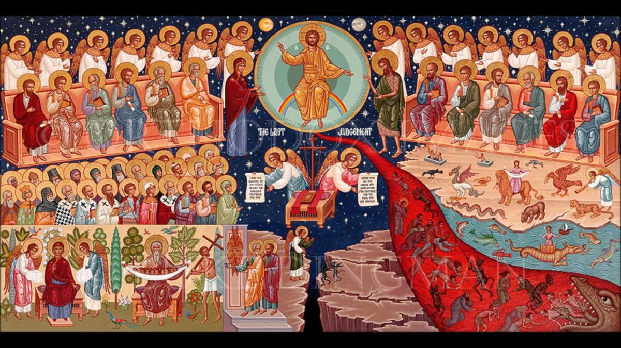
Last Judgment and The Resurrection of the Body
“The hour is coming when all who are in the tombs will hear his voice and come forth, those who have done good, to the resurrection of life, and those who have done evil, to the resurrection of judgment.” (Jn 5:28-29)
All bodies will be raised from the dead and will share in the punishment or reward of the soul
Then there will be a new heaven and a new earth
In the resurrection to life, the new creation will share in the glory of God
Both the new universe and all people in Heaven will experience what perfect happiness and fulfillment is
Notes:
Death will be definitively conquered

Slide 17
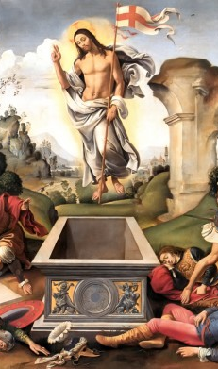
The Resurrected Body
“It does not yet appear what we shall be, but we know that when he appears we shall be like him, for we shall see him as he is.” (1 Jn 3:2)
Since we know what Christ’s body was like, we can determine some of the qualities of our resurrected body
There are four traditional characteristics of the resurrected body
Impassibility – The body will not be able to die or suffer
Agility – There will be no heaviness or sluggishness in the body; the body will be able to go wherever the soul pleases; e.g. road to Emmaus
Subtility – We will be able to pass through any other bodily or material objects; e.g. when Jesus passed through the door before Pentecost
Clarity – Our bodies will shine with the glory of God; e.g. like at the transfiguration
It is our bodies “this flesh” that will be raised and glorified
Notes:
Agility – road to Emmaus when Jesus appears and disappears

Slide 18
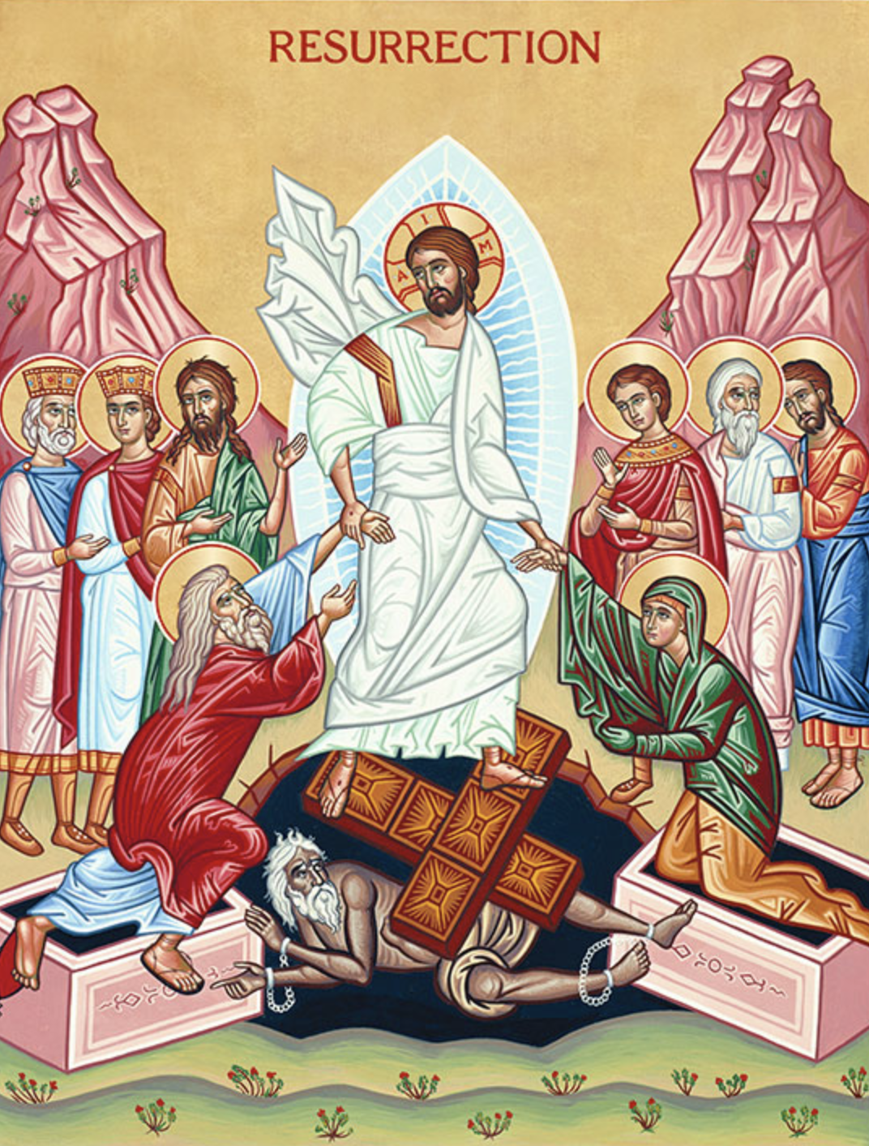
“For our sake he was crucified under Pontius Pilate, he suffered, died, and was buried. On the third day he rose again in fulfillment of the Scriptures”
Our icon of The Resurrection shows Christ's triumphant descent into hades after His death on the Cross on Great Friday.
As described in the writings of Nicodemus, we see Him freeing those souls held in the bondage of death, and also bestowing freedom on those righteous souls who were as yet unable to enter Paradise.
Standing on either side of Christ are: King David, Solomon, Saint John the Baptist, Abel the Righteous, and the Prophets Isaiah and Jeremiah. Raising them up the Savior brings them into Paradise and sets them free.
He also raises Adam and Eve by the hands from their tombs, symbolizing the freeing of mankind from its imprisonment in fallen nature that was accomplished by the Resurrection.
Christ stands on the fallen gates/doors of Hell and Lucifer lies chained and crushed beneath them, symbolizing the victory of the divine over evil.

Slide 19
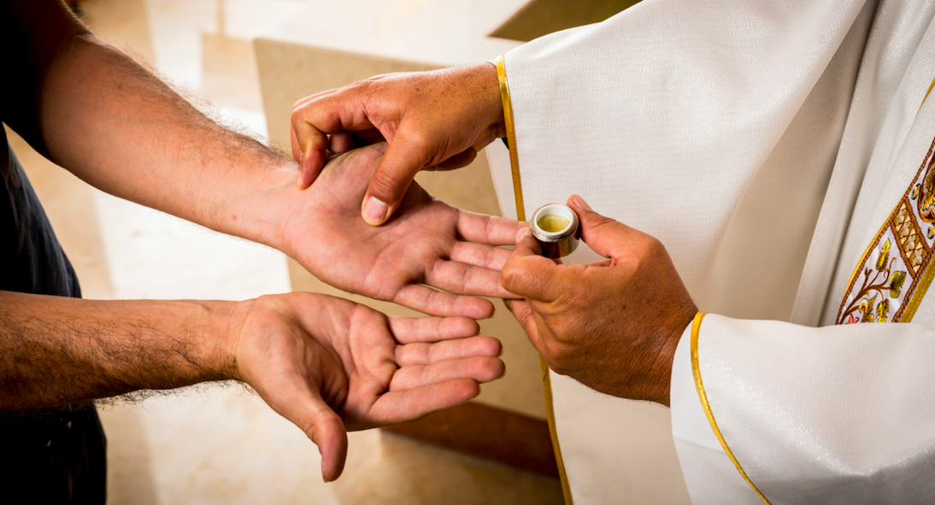
Sacraments: Anointing of the Sick
In the Church's Sacrament of Anointing of the Sick, through the ministry of the priest, it is Jesus who touches the sick to heal them from sin – and sometimes even from physical ailment. His cures were signs of the arrival of the Kingdom of God. The core message of his healing tells us of his plan to conquer sin and death by his dying and rising.
The Rite of Anointing tells us there is no need to wait until a person is at the point of death to receive the Sacrament. A careful judgment about the serious nature of the illness is sufficient. (Formerly known as: Last Rites, Extreme Unction)
When the Sacrament of Anointing of the Sick is given, the hoped-for effect is that, if it be God's will, the person be physically healed of illness. But even if there is no physical healing, the primary effect of the Sacrament is a spiritual healing by which the sick person receives the Holy Spirit's gift of peace and courage to deal with the difficulties that accompany serious illness or the frailty of old age.
Notes:
Death will be definitively conquered

